Slide 1

Azure Fundamentals – VMs Storage & Networking
Bernhard Frank
Cloud Solution Architect
Microsoft Deutschland GmbH
aka.ms/bfrank
Jose Moreno
Cloud Solution Architect
Microsoft Deutschland GmbH

Slide 2
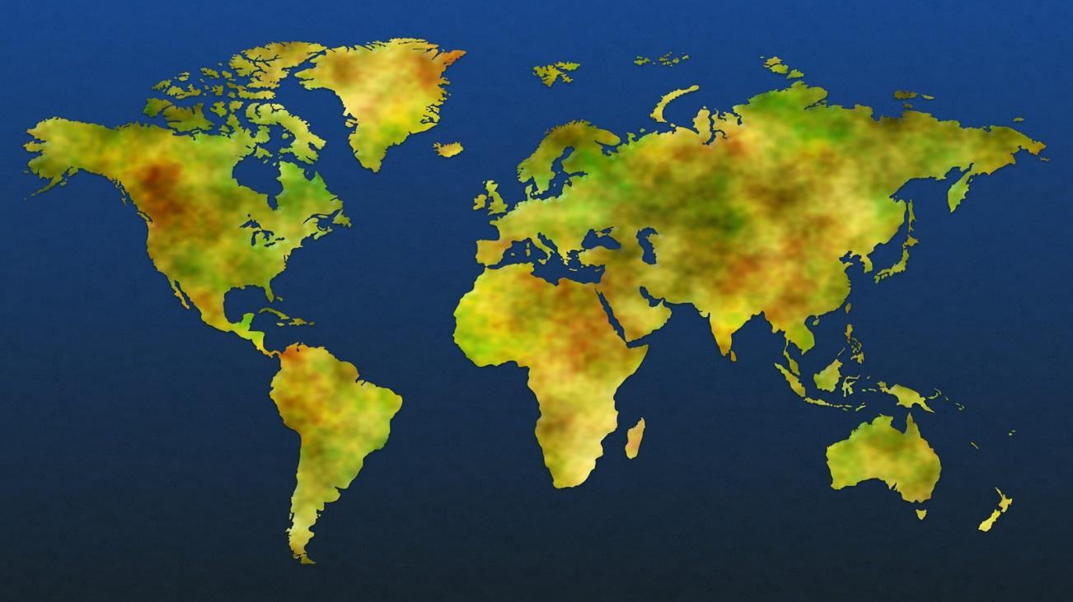
Azure regions
US Gov Lowa
Central US
Canada East
UK South
Korea Central
West US 2
North Europe
West Europe
US DoD Central
Germany Northeast
Korea South
West US
Canada Central
UK West
Germany Central
US Gov Arizona
North Central US
France Central
China North
Japan East
US DoD East
France South
China East
East Asia
Japan West
West Central US
East US
West India
East US 2
Central India
US Gov Texas
US Gov Virginia
South Central US
South India
Southeast Asia
Brazil South
Australia Southeast
Australia East

Slide 3


Slide 4
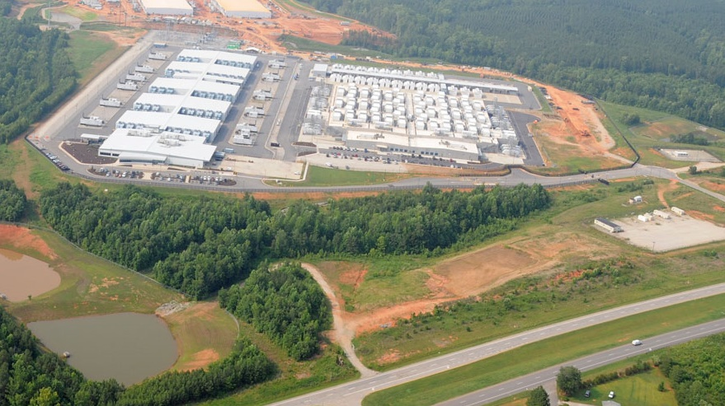

Slide 5
https://www.youtube.com/watch?v=bqZrejosqWU

Slide 6
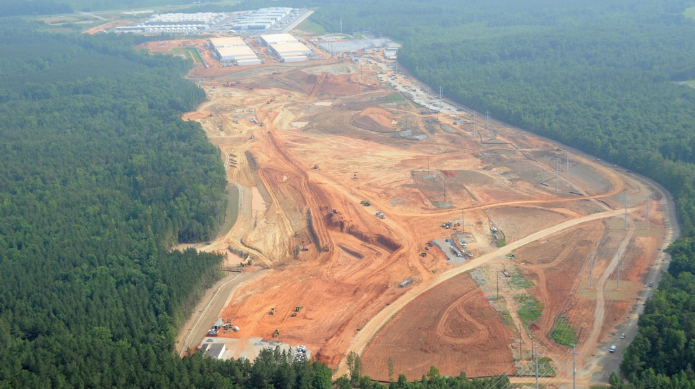

Slide 7
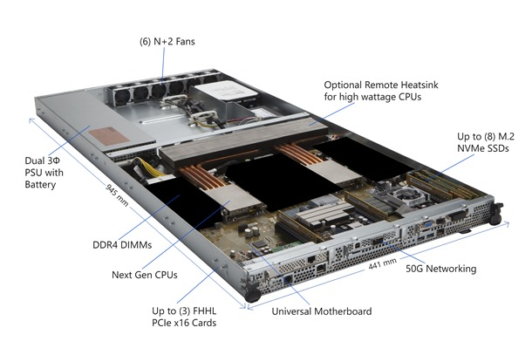
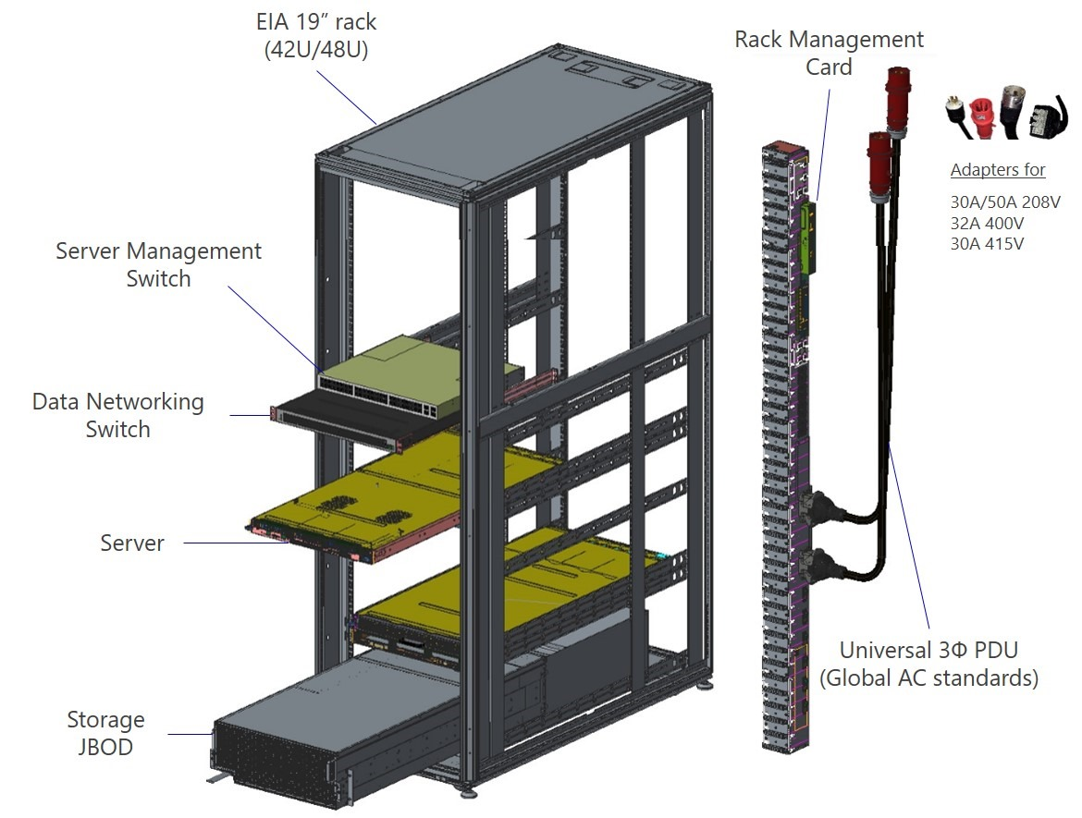
Global Foundation Services*)
Operates Azure
Contributes to: Open Compute Project *)

Slide 8
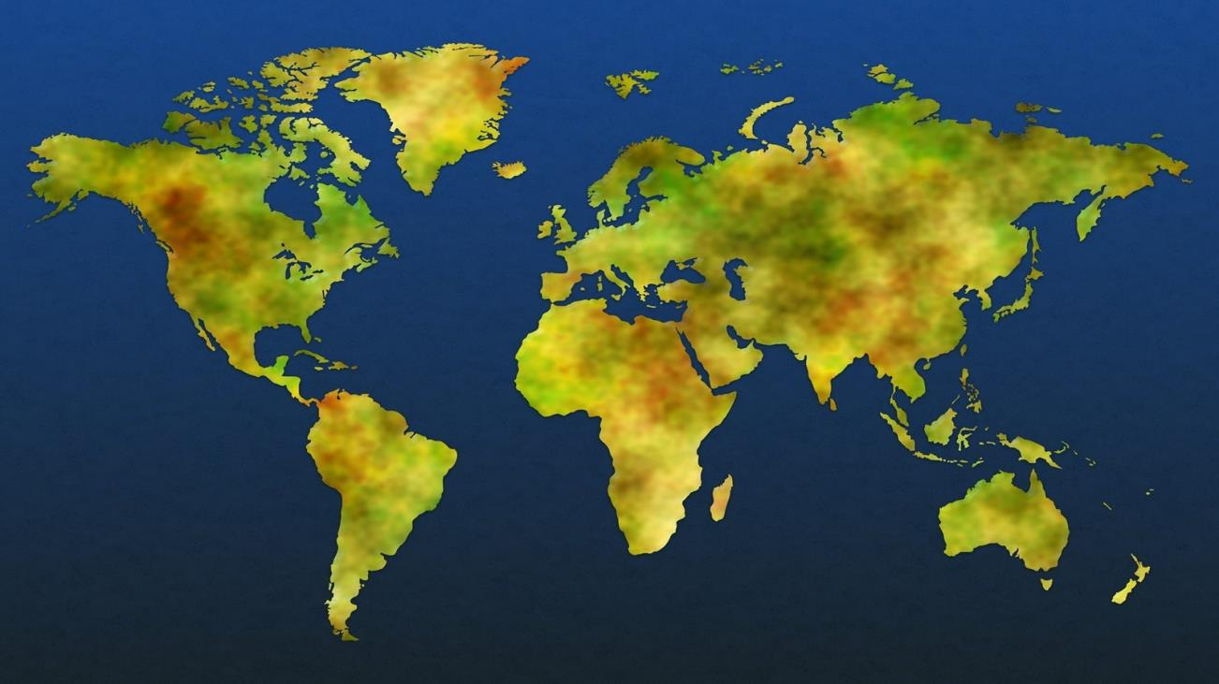
Microsoft infrastructure investments
Edge Nodes
Azure Regions
Data Centers
MS Network

Slide 9
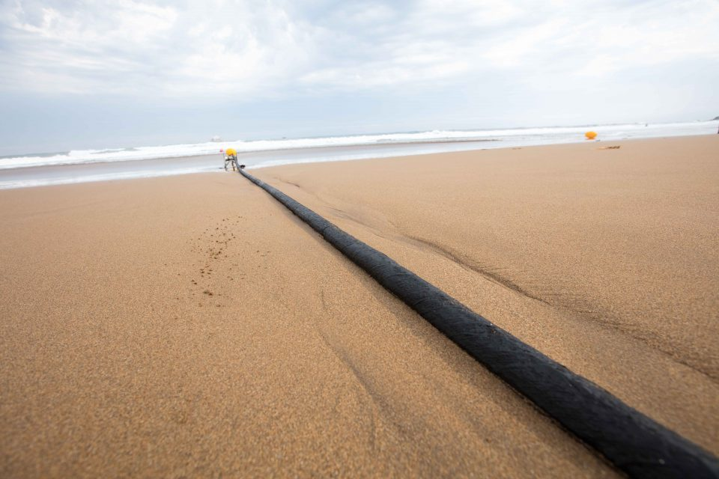
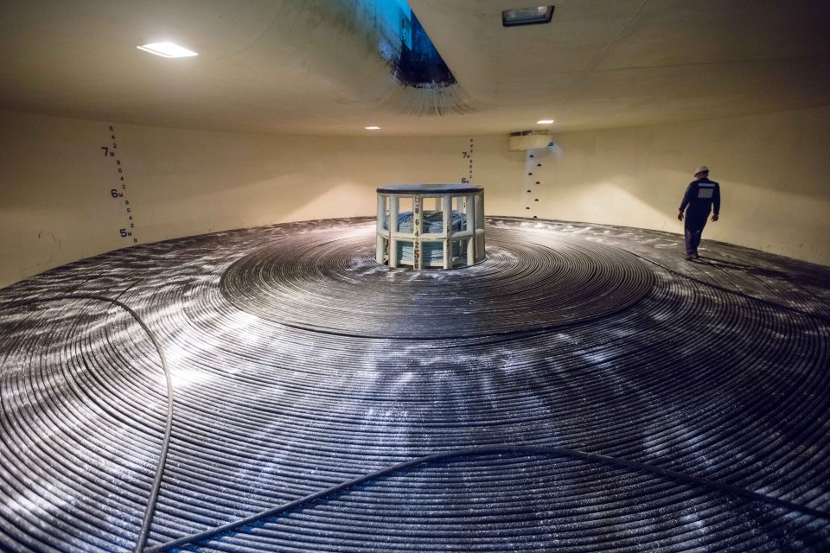
Microsoft, Facebook and Telxius complete the highest-capacity subsea cable to cross the Atlantic
Virginia and Bilbao
4,000-miles
160 Tbps
(=820 Single Sided Blue Rays / Sec)

Slide 10

Erde
Mond
3x
ca. 380.000 km

Slide 11
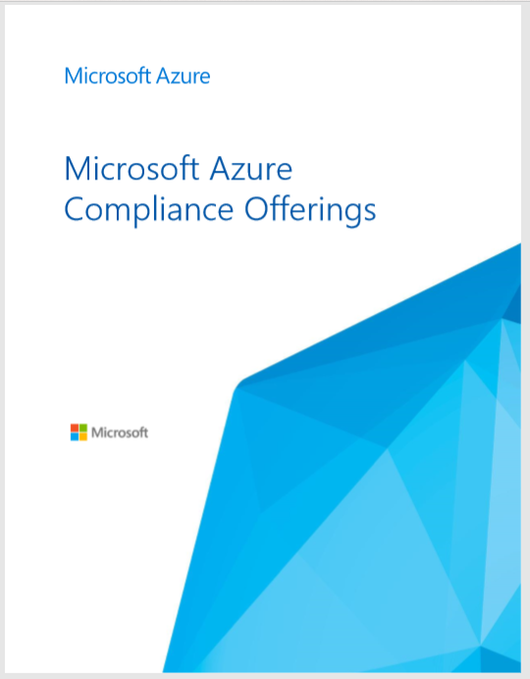
Azure covers 70 compliance offerings
Azure has the deepest and most comprehensive compliance coverage in the industry
Global
ISO 27001:2013
ISO 27017:2015
ISO 27018:2014
ISO 22301:2012
ISO 9001:2015 ISO 20000-1:2011
SOC 1 Type 2
SOC 2 Type 2
SOC 3
CSA STAR Certification
CSA STAR Attestation
CSA STAR Self-Assessment WCAG 2.0
US Gov
FedRAMP High
FedRAMP Moderate EAR
DoD DISA SRG Level 5
DoD DISA SRG Level 4 DoD DISA SRG Level 2 DFARS
DoE 10 CFR Part 810 NIST SP 800-171
NIST CSF
Section 508 VPATs
FIPS 140-2 ITAR
CJIS
IRS 1075
Industry
PCI DSS Level 1
GLBA
FFIEC Shared Assessments FISC (Japan)
FCA (UK) MAS + ABS (Singapore)
23 NYCRR 500 HIPAA BAA HITRUST
21 CFR Part 11 (GxP) MARS-E NHS IG Toolkit (UK)
NEN 7510:2011 (Netherlands)
FERPA
CDSA
MPAA
FACT (UK) DPP (UK)
Regional
Argentina PDPA
Australia CCSL / IRAP
Canada Privacy Laws China GB 18030:2005 China DJCP (MLPS) Level 3
China TRUCS / CCCPPF
EN 301 549
EU ENISA IAF EU Model Clauses EU – US Privacy Shield Germany IT-Grundschutz workbook
Germany C5 India MeitY
Japan CS Mark Gold
Japan My Number Act Netherlands BIR 2012 New Zealand Gov CIO Fwk
Singapore MTCS Level 3
Spain ENS
Spain DPA UK Cyber Essentials Plus UK G-Cloud UK PASF
PDF Azure Compliance Offerings aka.ms/AzureCompliance

Slide 12
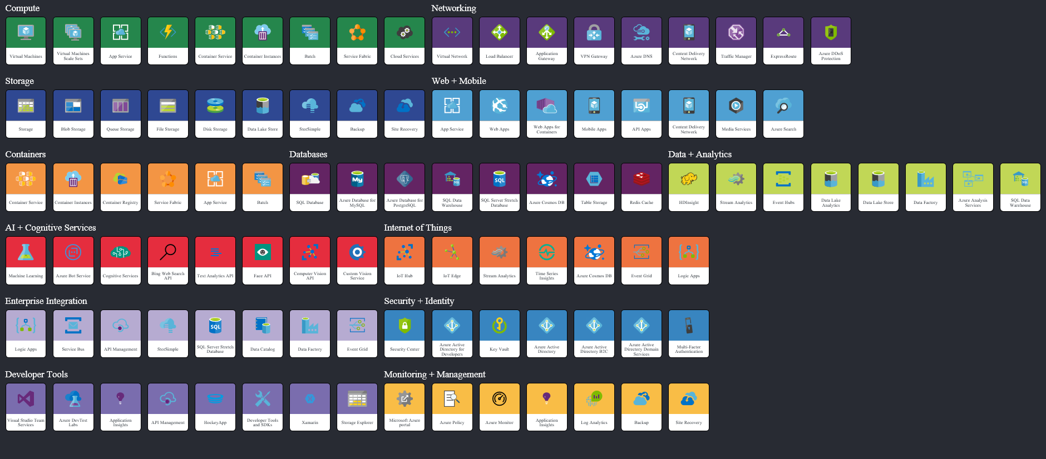
Azure Services
visit azureinteractives

Slide 13


Microsoft Azure Compute
Packaged Software
Infrastructure
(as a Service)
Platform
(as a Service)
Software
(as a Service)
You manage
Applications
Applications
Applications
Applications
Data
You manage
Data
Data
Data
Runtime
Runtime
Runtime
Runtime
Managed by vendor
You manage
Middleware
Middleware
Middleware
Managed by vendor
Middleware
O/S
O/S
O/S
O/S
Virtualization
Virtualization
Managed by vendor
Virtualization
Virtualization
Servers
Servers
Servers
Servers
Storage
Storage
Storage
Storage
Networking
Networking
Networking
Networking
Notes:
Slide Objectives
Explain the differences and relationship between IaaS, PaaS, and SaaS in more detail
Speaker Notes
Another way to look at the cloud services taxonomy and how this taxonomy maps to the components in an IT infrastructure is as follows:
Packaged software: With packaged software, a customer would be responsible for managing the entire stack, ranging from the network connectivity to the applications
IaaS:
With IaaS, the lower levels of the stack are managed by a vendor. Some of these components can be provided by traditional hosters. In fact, most of them have moved to a virtualized offering
Very few actually provide an OS
The customer is still responsible for managing the OS through the applications
An obvious benefit with IaaS is that it frees the developer from many concerns when provisioning physical or Virtual Machines (VMs)
This was one of the earliest and primary use cases for Amazon Web Services Elastic Cloud Compute (EC2)
Developers were able to readily provision VMs (Amazon Machine Images, abbreviated as AMIs) on EC2, develop and test solutions and, often, run the results in production
The only requirement was a credit card to pay for the services
PaaS:
With PaaS, everything from the network connectivity through the runtime is provided and managed by the platform vendor
Microsoft Azure fits best in this category today
In fact, because we do not provide access to the underlying virtualization or OS today, we are often referred to as not providing IaaS
PaaS offerings further reduce the developer burden by additionally supporting the platform runtime and related application services
With PaaS, the developer can immediately begin creating the business logic for an application
Potentially, the increase in productivity is considerable. In addition, since the hardware and operational aspects of the cloud platform are also managed by the cloud platform provider, applications can quickly be taken from an idea to reality
SaaS:
Finally, with SaaS, a vendor provides the application and abstracts you from all of the underlying components
[EDITOR] Biju
04 October 2013 Kindly provide substantiation for the claim made against third-party software.

Slide 14

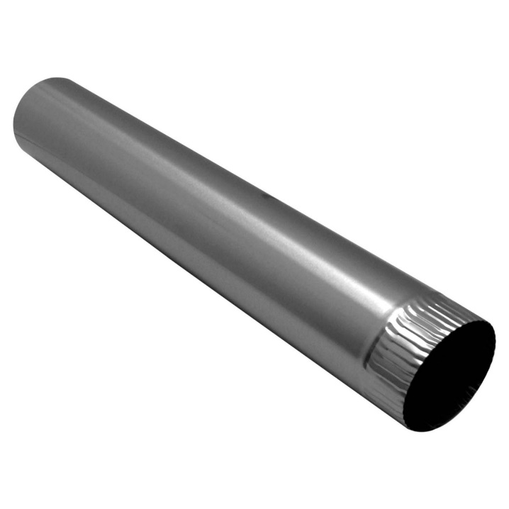
What makes an Azure Virtual Machine?
Storage resources
Managed Disks
Page Blobs
Storage accounts (page blobs) - Standard & Premium Storage
Compute resources
Virtual machines
VM extensions
Networking resources
Virtual networks
Network interface cards (NICs)
Load balancers
IP addresses
Network Security Groups

Slide 15
Demo>
_
Notes:
deployment von den azure quickstart templates….
re-deployment einer lösung aus Azure heraus….

Slide 16
Selecting the right VM size
Highest value
Largest scale-up
A
D
DV2
G
N
Highest value
SSD Storage Fast CPUs
>80,000 IOPs
Premium Storage
New generation of D family VMs
Most memory fastest CPUs
GPU-enabled virtual machines
35% faster than D
Intel E5-2673 v3 CPUs
NVIDIA GPUs
Remote visualization
Compute-intensive + RDMA

Slide 17
Wie viele VM Typen gibt es überhaupt?

Slide 18
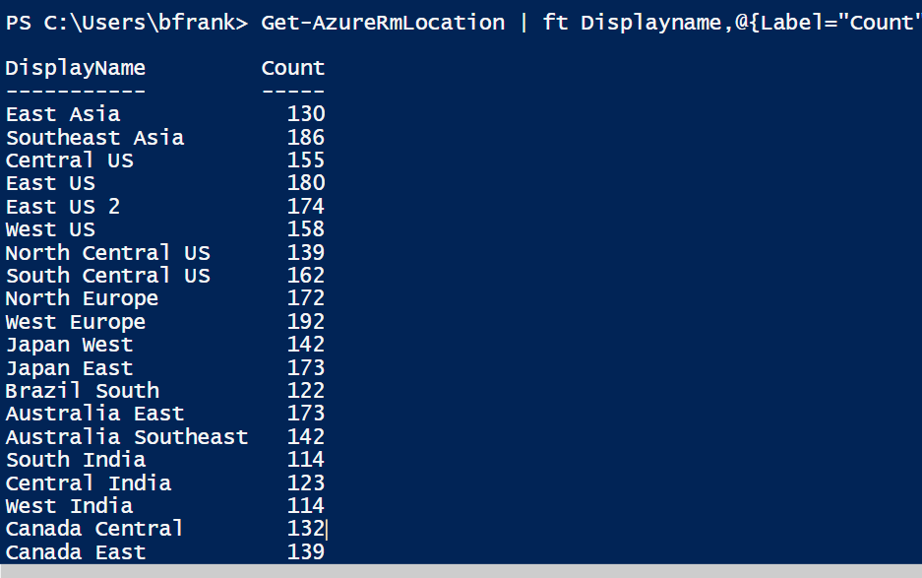
Get-AzureRmLocation | ft Displayname,@{Label="Count";Expression = {(Get-AzureRmVMSize -Location $_.Location).count}} -AutoSize
Notes:
Get-AzureRmLocation | ft Displayname,@{Label="Count";Expression = {(Get-AzureRmVMSize -Location $_.Location).count}} -AutoSize

Slide 19
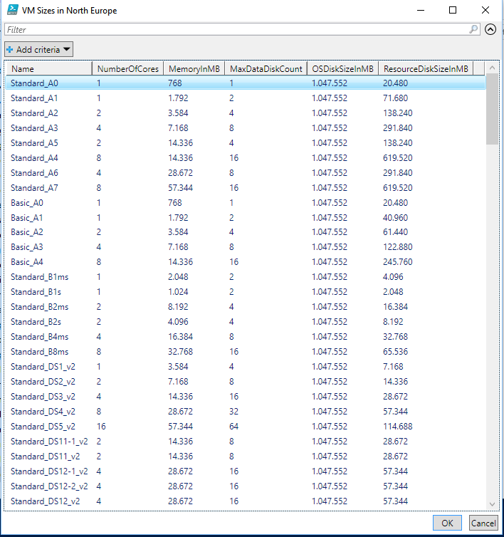
VM Typen in North Europe?
Notes:
c:\windows\system32\WindowsPowerShell\v1.0\PowerShell_ISE.exe -file "C:\work\work\1_Daten & Wissensspeicher\My Talks\CDC-Germany 2018\Azure für Einsteiger – oder IaaS Konzepte die IT Pros über die MS Cloud kennen sollten.ps1"

Slide 20
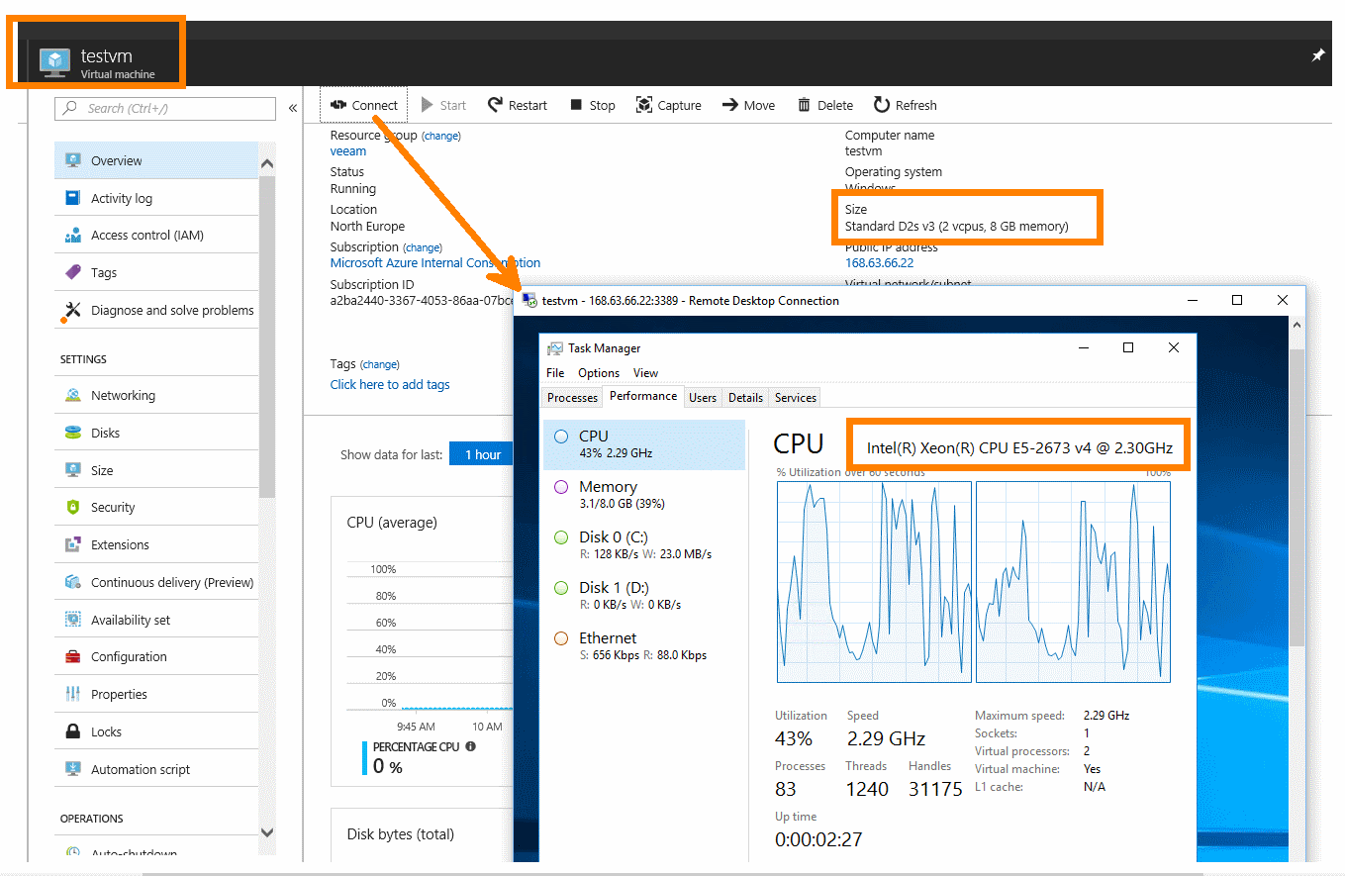
…Welche CPU sieht die VM?
Hyper-V virtual Core
die CPU des physischen Hosts

Slide 21
Die Dv2 und Dv3 laufen mit gleicher Host CPU – welche VM ist schneller?
keine, beide sind gleich schnell
eine Dv3^{*)}
eine Dv2^{*)}
Notes:
Dv3-Series verfügt über die gleichen Prozessoren wie die Dv2-Serie, aber in einer Hyper-Threading-Konfiguration -> haben weniger Rechenpower und sind daher günstiger zu haben.
Preisunterschied
->Demo machen mit den ACUs…

Slide 22
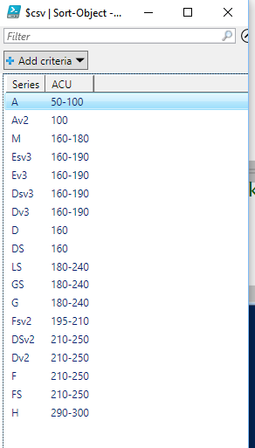
Was ist eine ACU? *)
= Azure Compute Unit
Use to compare compute (CPU) performance across Azure SKUs
How fast can a SKU run a standard benchmark.
Standard_A1 = 100
viele SKUs verwenden Intel® Turbo technology to increase CPU frequency
vCPU: Core
1:1 = Host ‚nicht überbucht‘
2:1 = hyperthreading auf Host aktiviert
Notes:
ACUs marked with a * use Intel® Turbo technology to increase CPU frequency and provide a performance boost. The amount of the boost can vary based on the VM size, workload, and other workloads running on the same host.

Slide 23
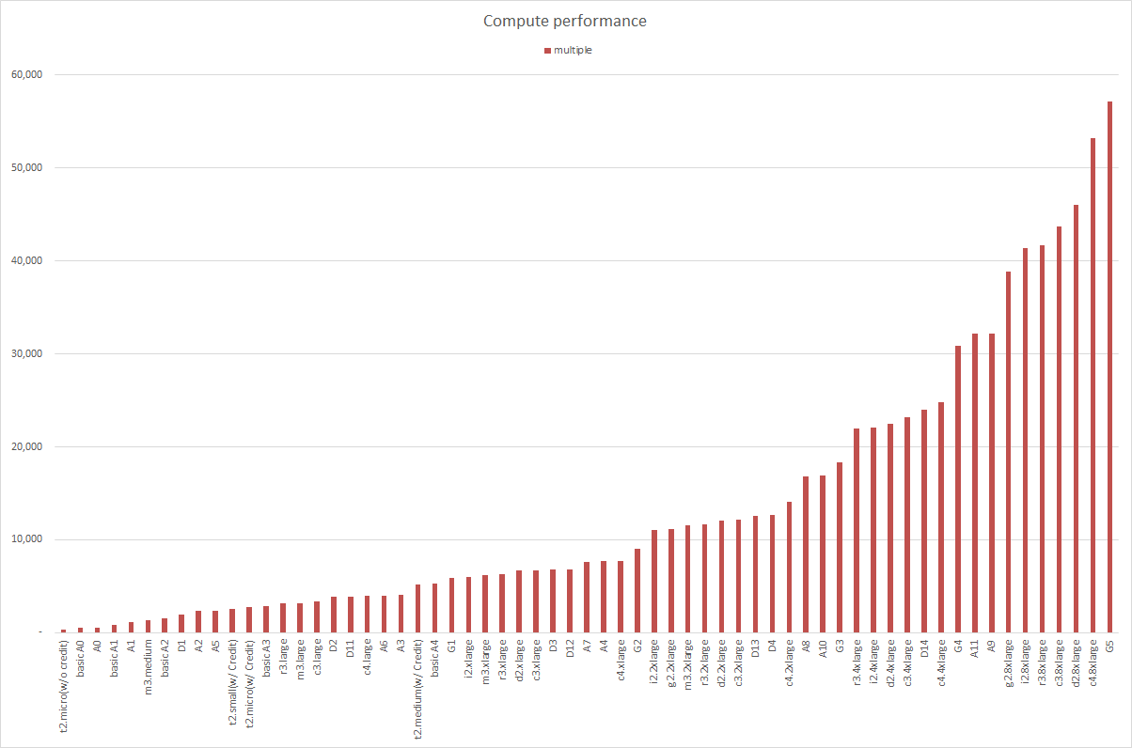
https://blogs.technet.microsoft.com/korea_infra_guys/2015/05/14/aws-vs-azure-compute-performance-comparison/
Using GeekBench, No performace gurantee

Slide 24
VM Typen à la Carte,…*)
General purpose (typen A,D)
B-series burstable VMs are ideal for workloads that do not need the full performance of the CPU continuously
Compute optimized (F)
Memory optimized (M,D,E)
Storage optimized (L)
GPU (N)
NC-series VMs are powered by the NVIDIA Tesla K80 card.
High performance compute (H,A)

Slide 25
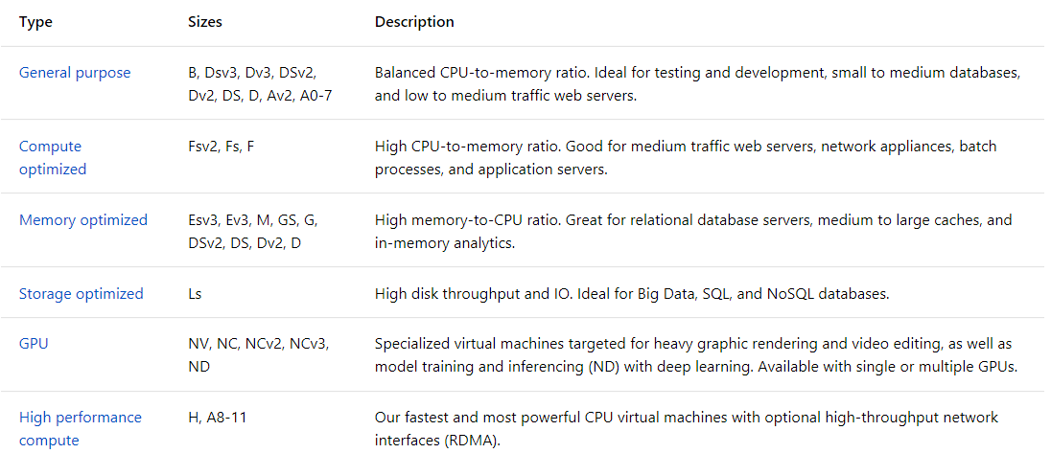
VM Typen à la Carte,…*)
Notes:
[General Purpose]
A Series – „Anfänger“
D Series – CPU++ , SSD für Temp Disk (D:)
Dv2 – wie D + schnellere Host CPU+++
Dv3 – gleiche CPU wie Dv2 aber Hyperthreading an -> weniger €

Slide 26
Was ist der Unterschied zwischen –S und nicht –S Virtuelle Maschinen? (z.B. DS2v2 vs. D2v2)
S für slow – ältere Host CPU – VM langsamer – daher billiger
S für Standard Storage – HDD basierende vDisk
S für Premium Storage – SSD basierend vDisk
Notes:
kosten sind im übrigen gleich….

Slide 27
ACUs ist eine Sache,…*)
Was kostet was?
Wie viele Daten Disks bekomme ich dran?
-> IOPS
Wieviel Netzwerk-Bandbreite bekomme ich?
Spezielle HW:
RDMA
GPU
-------------
keine Panik! -> man kann re-Sizen

Slide 28
…alle Azure VMs haben mindestens…?
1
2
3
..virtuelle Hard Disk(s).
BTW: das sind fixed size .vhd Dateien. *)

Slide 29
Virtual machine storage architecture
Azure virtual machine
C:\
OS Disk (127 GB)
D:\
Temporary disk
(Contents can be lost)
E:\, F:\, etc.
Data disks (1 TB)
Up to 64 disks
Disk cache
Azure Blob
Notes:
Temporary disk – this disk is not persistent. Great for log files, temporary installation files. Etc.
Can add additional data disk

Slide 30
Welche Platte nehme ich denn nun?

Slide 31
Azure Storage services *)
Azure Storage services
Azure Blobs
Azure Files
Azure Queues
Azure Tables
Block Blobs
(binary data)
Page Blobs (random access e.g. .vhd)
Standard Storage
Premium Storage
Append Blobs
(optimized for append e.g. logs)

Slide 32
Unmanaged vs. Managed Disks *)
 | Unmanaged Disks | Managed Disks
History | Original | GA Feb. 2017
Storage Account | You manage | Azure managed
Storage Types | Standard / Premium | Standard / Premium
1 Storage Account IOPS Limit | 20,000 IOPS ! | Azure handles this for you
Standard Storage Pricing | Pay only space you are using | You pay the provisioned price
Beispiel Standard | 50% S10: (64 GB – 10kTransaktionen) = 5,46 €/Monat 100% S10: (128 GB – 10kTransaktionen) = 7,89 €/Monat | S10 [HDD] (128GB – 10kTransaktionen) = 4,97€/Monat Neu E10 [SSD]- 4,92€/Monat …
Premium Storage Pricing | You pay the provisioned price | You pay the provisioned price
Beispiel Premium | P10 (128GB,500IOPs,100MB/s) = 16,62 €/Monat | P10 = 16,62€/Monat
Managed Disk Pricing *)
-> Default: managed disks
Preise: Stand (North Europe) - 13.06.2018

Slide 33
Types of disk storage for Azure Windows VMs
Standard Storage
HDD based - cost-effective storage
can be attached to all Azure VMs
Supports Blobs, Files, Tables, and Queues
€ = Volume of data stored per month + quantity and types of operations performed + Data redundancy
1 disk limit: 4TB | max. 500 (8k) IOPS | max 60MB/s
Premium Storage (the „S“ in the VM type)
SSD based, Page Blobs only (= VM disks)
Optimized for low latency or high bandwidth
Recommended for VMs
Various sizes: size defines €€€ & IOPS

Slide 34
Storage
https://docs.microsoft.com/en-us/azure/storage/common/storage-account-options?toc=%2fazure%2fstorage%2fblobs%2ftoc.json
Azure Storage account options
Understanding Block Blobs, Append Blobs, and Page Blobs
https://docs.microsoft.com/en-us/rest/api/storageservices/understanding-block-blobs--append-blobs--and-page-blobs

Slide 35
Virtual machine standard storage
Page Blobs
3 copies
VHD disks, 1 TB per disk (64TB Total)
500 IOPs (32,000 IOPS total)
Notes:
When their saves – its done 3 times before we even say its done. They are in the form of VHDs.
We do limit them to 1 TB.
Premium storage is a lot higher

Slide 36
Virtual machine standard storage
Defend against regional disasters
West DC
> 400 miles
East DC
Geo replication
Notes:
Geopolitical boundaries
Regional datacenter
Not coping from Europe to the US

Slide 37
Persistent Disk Management – Windows OS
C:\ = OS Disk
D:\ = Non-Persistent Cache Disk
E:\, F:\. G:\ and all subsequent Data Disks—you will need to attach and format them
Capability | OS Disk | Data Disk
Host Cache Default | ReadWrite | None
Max Capacity | 1023 GB | 1023 GB
Hot Update | Cache Setting requires a reboot | Change Cache without reboot, Add/Remove without reboot
Notes:
Persistent Disk Management
The OS Ddisk is up to 127 GB and the data disk is 1TB
The D:\ drive is for non-persistent cache
The C:\ drive is the OS disk
E:\ and all subsequent drive letters represent data disks
[EDITOR] TWB_Trevor:
08 October 2013 Kindly validate the edit
[EDITOR] TWB_Trevor:
08 October 2013 Is this supposed to be “Ddisk” or just “disk”?

Slide 38
Optimizing storage performance
General Purpose Performance
Premium storage disks
Read-only caching
Database Logfiles
Premium storage disks
No caching
Standard Performance
Standard storage
No caching if >4 disks
Stripe for higher IOPS

Slide 39
Introduction to Disks and Images
OS Images
Microsoft
Partner
User
Base OS image for new VMs
Sysprepped/Generalized/Read-only
Created by uploading or by capture
Disks
OS Disks
Data Disks
Writable disks for VMs
Created during VM creation or during upload of existing Virtual Hard Disks (VHDs)
Currently, in ARM, creating a VM from my customized image requires PowerShell or JSON template.
Portal is not supported.
Notes:
Slide Objective
Explain the workflow for creating a custom image in the cloud.
Notes
This use case is about using the Capture feature of IaaS to create OS images. You start with a base Virtual Hard Disk (VHD) and then customize it with software binaries, registry settings etc. Next, you run sysprep.exe and generalize/shutdown the OS. You can then upload it, if the image is being coming from on-premises, or click the capture button if you created the VM in the cloud.
Capture allows you to take a generalized VM and save the underlying VHD as a new image in your Image library.
Disks and Images
The idea of disks and images are key concepts related to VMs
The difference is between OS images provided by Microsoft, users or partners.
The difference is the fact that those images have been sysprepped and generalized
They can be uploaded, or captured
You can create them, add whatever you need, then capture for repeated use
We are seeing customers who want to install SharePoint in one of these images, save it, and use it
For disks, this represents a .vhd machine that you have already booted up somewhere and that is running sysprep on, may ruin something in its environment. Also, it is a little more risky because if you do not already have remote desktop set up on the image, you would not be able to turn it on in the Cloud like Microsoft does for the OS images. Otherwise, the process is the same as how it works in Microsoft Azure, where an ISO is created, an unattended.xml file and storage is used

Slide 40
Image Mobility
On-premises
Cloud
Blob Storage
MyApp.vhd
Notes:
[EDITOR] Gaiyasi:
Thursday, October 03, 2013
Kindly expand AWS. Is it a reference to Amazon Web Services?
[EDITOR] Biju
Thursday, October 03, 2013 Kindly validate the edit. Original: Speak to images as page blobs.
[EDITOR] Biju.K
Kindly validate the comparison claim made. LCA recommends substantiation of claims made against third-party products.
Slide Objective
Explain the benefits of image mobility.
Notes
One of the key benefits of IaaS is flexibility and control. The Microsoft Azure solution provides you the capability of moving VHDs to the cloud, and to copy of the VHD back down and run it locally or on another cloud service as well. It is ideal for testing production issues or any other scenario that requires you to have a copy of the production server.
Communicate to images as page blobs:
AWS offers a storage service in its PaaS model that differs from its IaaS offering, which is stored on Storage Area Networks (SANs). This means that you do not get much mobility.
Microsoft Azure offers storage for PaaS and IaaS in a unified fashion, so blob storage for VHDs is accessible via the same APIs available to any blob storage. This means that we can pull images down, run them in Hyper-V, push them back to Microsoft Azure, and repeat as often as required.

Slide 41
Bring Your Own Server/VHD
On-premises
Cloud
MyApp.vhd
On-premises Virtual Server
Provision VM from an image or a disk using a portal, a script or an API
Use Case
Forklift Migration of VMs
Sysprepped Images
Use Add-AzureVHD to upload
VHD must be fixed disk
* Disk must be converted before upload
Upload VHD
Blob storage
Create disk or
image
Notes:
Slide Objective
Explain the workflow for creating a custom image in the cloud.
Notes
This use case is about using the Capture feature of IaaS to create OS images. You start with a base Virtual Hard Disk (VHD) and then customize it with software binaries, registry settings etc. Next, you run sysprep.exe and generalize/shutdown the OS. You can then upload it, if the image is being coming from on-premises, or click the capture button if you created the VM in the cloud.
Capture allows you to take a generalized VM and save the underlying VHD as a new image in your Image library.
Bring your Own Server/VHD
These are sysprepped images, and they must be fixed disk
Uploading images to Azure http://michaelwasham.com/windows-azure-powershell-reference-guide/uploading-and-downloading-vhds-to-windows-azure/
Use Add-AzureVHD PowerShell cmdlet to upload
[EDITOR] TWB_Trevor:
08 October 2013 The first two paragraphs of the notes content is repeated - same as notes page 25. Kindly verify.

Slide 42
Imaging VMs in the Cloud
Cloud
Blob storage
Identical or similar deployment instances use a common OS image as a starting point
Base.VHD
Boot
VM
Blob storage
Customize
VHD
Generalize
VHD
Capture
VM
Capture VM saves the customized image to your image library
Notes:
Slide Objective
Explain the workflow for creating a custom image in the cloud.
Notes
This use case is about using the Capture feature of IaaS to create OS images. You start with a base Virtual Hard Disk (VHD) and then customize it with software binaries, registry settings etc. Next, you run sysprep.exe and generalize/shutdown the OS. You can then upload it, if the image is being created on-premises, or click the Capture button if you created the VM in the cloud.
Capture allows you to take a generalized VM and save the underlying VHD as a new image in your Image library.
The steps on the slide show that you can not only use a base VHD that you put into storage, but you can also modify the base image in storage, capture it, and then use that as the new base.
How do you generalize?
Sysprep
What happens to the base?
The base becomes a sysprepped image
[EDITOR] TWB_Trevor:
08 October 2013 The first two paragraphs of the notes content is repeated - same as notes page 25. Kindly verify.

Slide 43
…ich habe das Passwort meiner Azure VM ‘verlegt’ was mache ich jetzt?
den ‚Krempel‘ neu installieren
via serielle Console drangehen und ein neues setzen
VM Access Extension nutzen

Slide 44
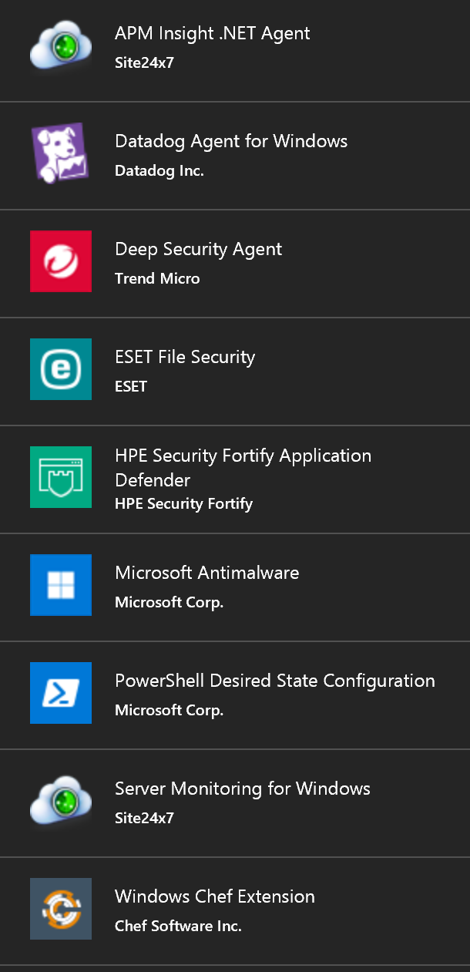
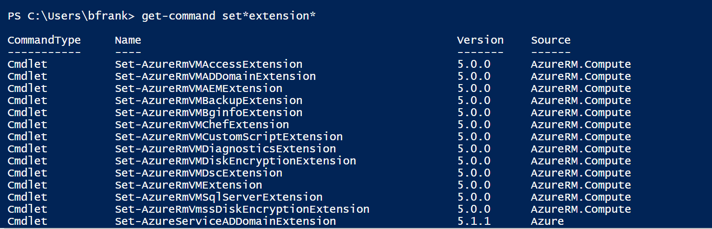
Azure VM Agent and Extensions
VM Agent is used to install, configure, manage and run Azure VM Extensions
Installs, configures, and removes VM extensions on instances of Azure VMs
Enable via Portal or PowerShell
Available for Windows and Linux
VM Extensions provide dynamic features that Microsoft and other third parties provide
Modify security and identity features, such as resetting account values and using antimalware
Start, stop, or configure monitoring and diagnostics
Reset or install connectivity features, such as RDP and SSH
Diagnose, monitor, and manage your VMs
Notes:
$vm = Get-AzureVM –serviceName
$svc –Name $name $vm.VM.ProvisionGuestAgent = $TRUE
Update-AzureVM –Name $name –VM $vm.VM –ServiceName $svc
Azure VM Extensions and Features
https://msdn.microsoft.com/en-us/library/dn606311.aspx

Slide 45
Demo>
_
Notes:
Set-AzureRmVMAccessExtension -ResourceGroupName "NestedHyper-V" -VMName "HyperV-01" -Name "ContosoTest" -Credential (get-credential)

Slide 46
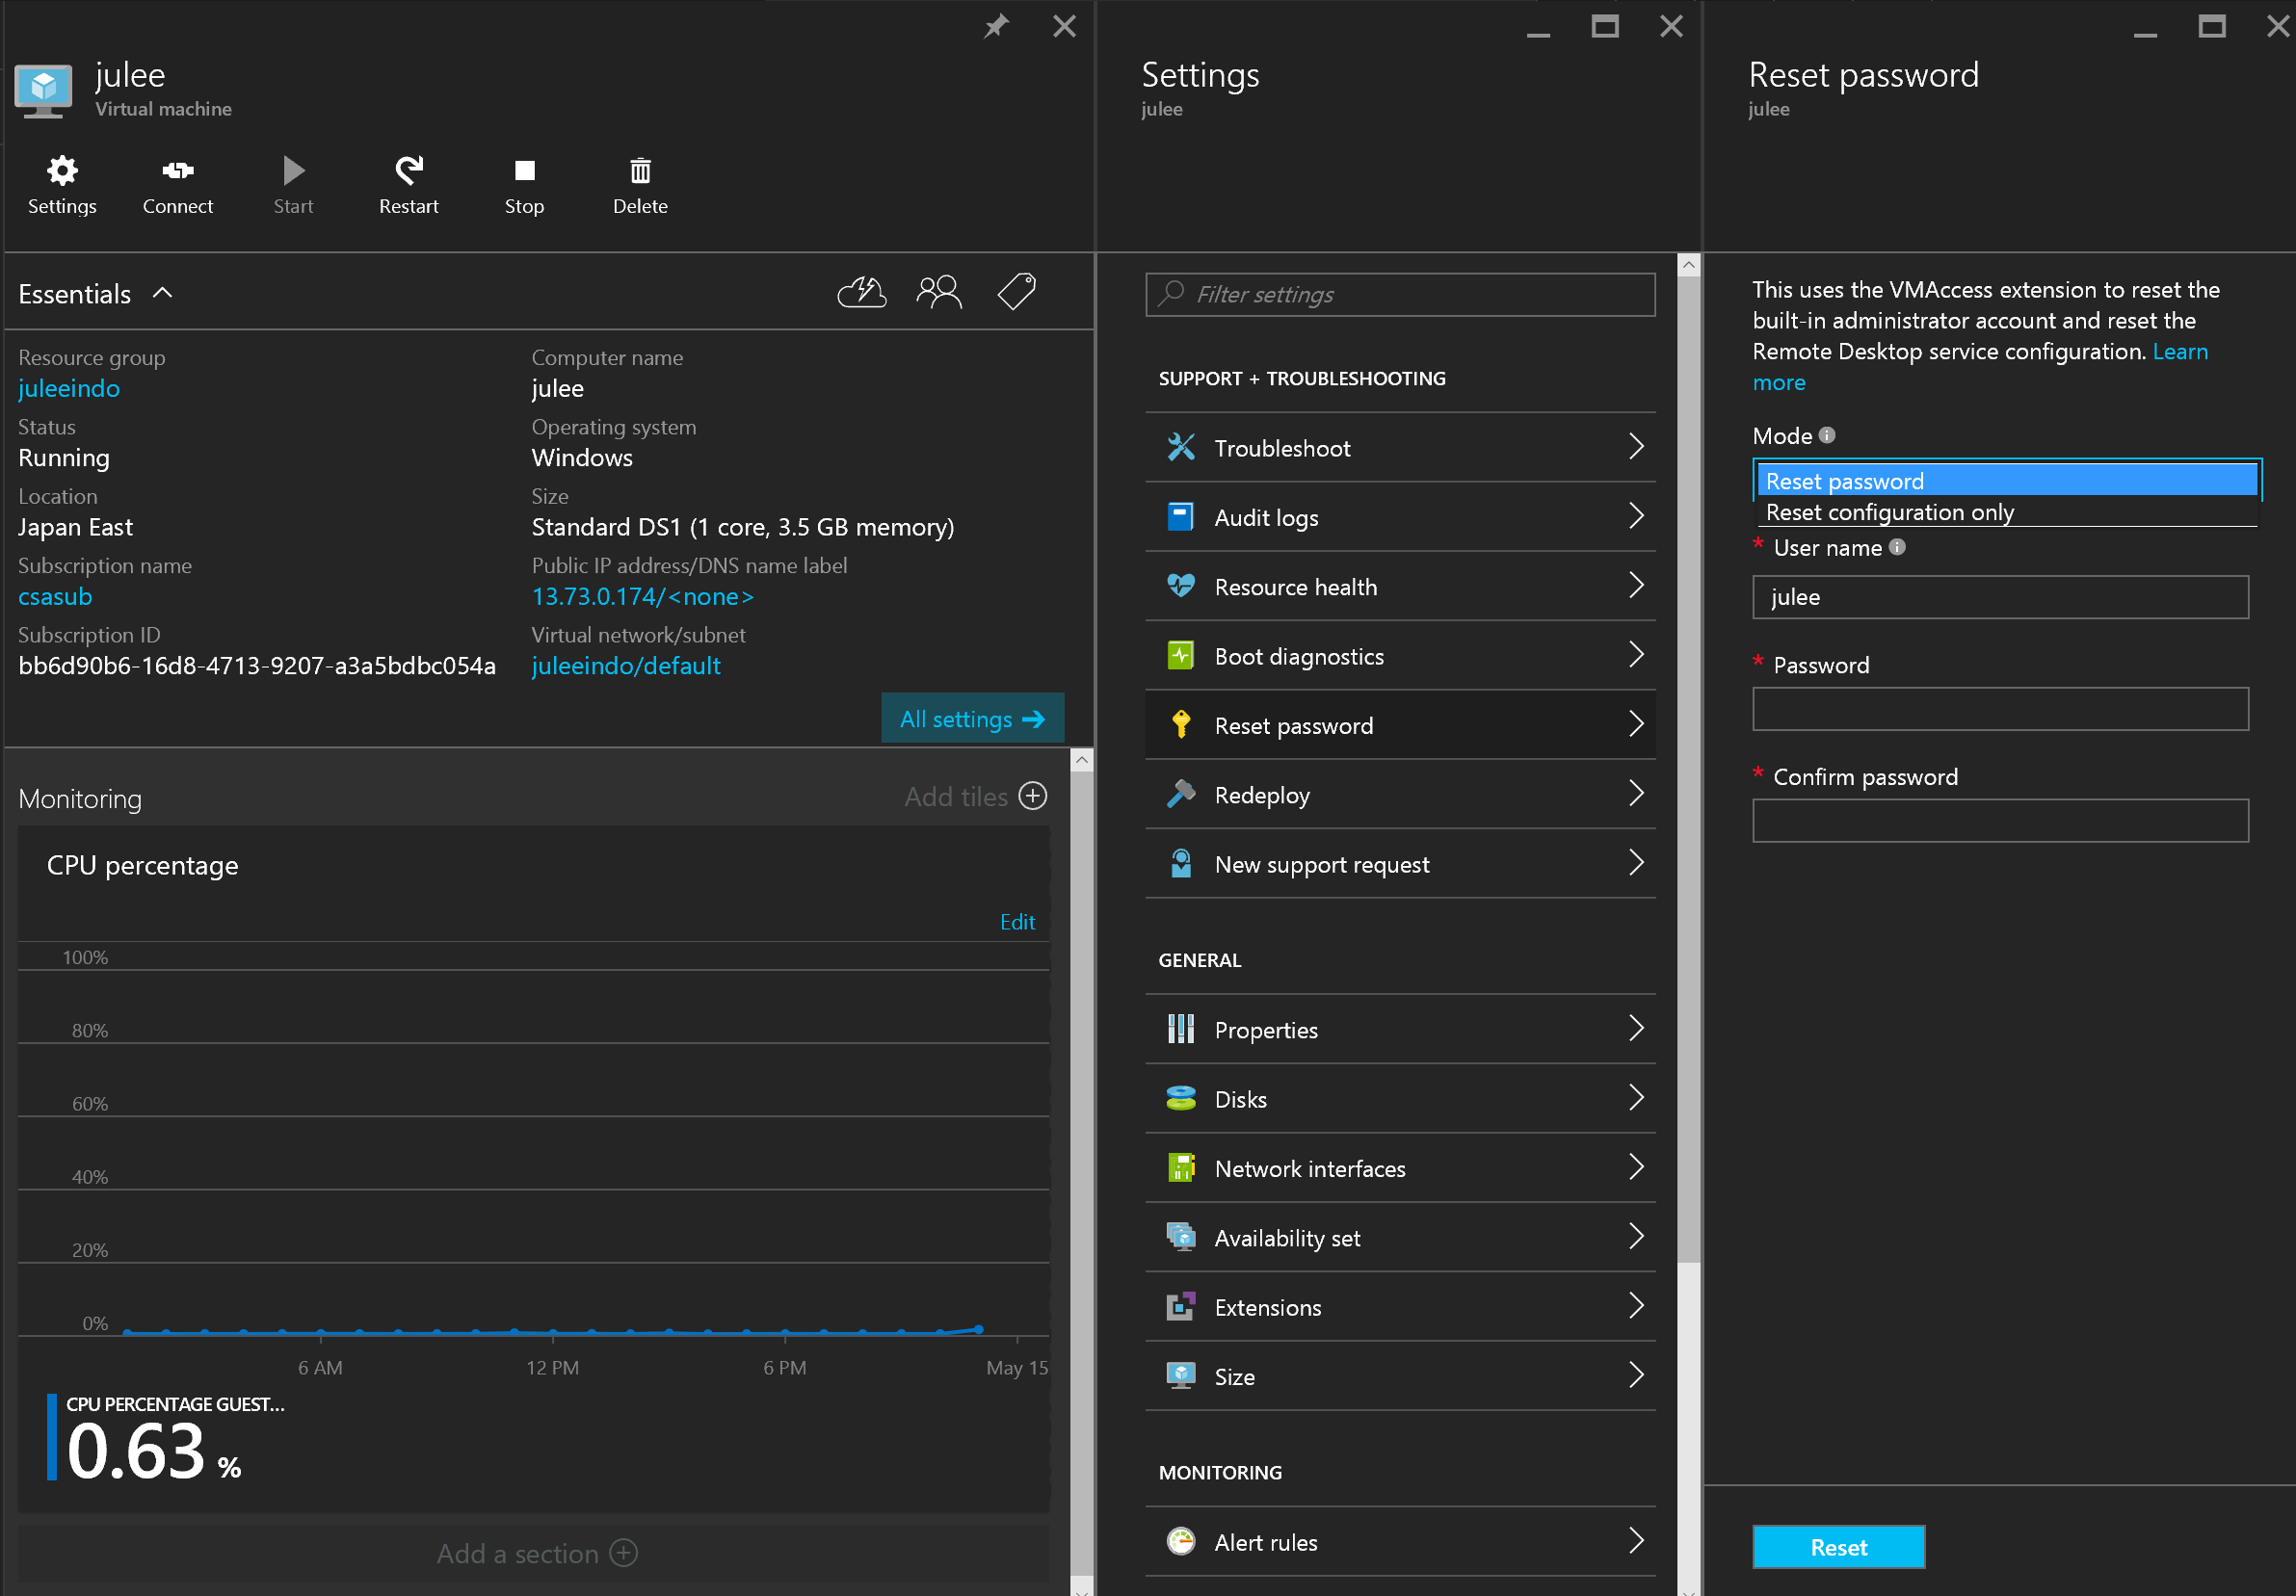
VM Access Extension
VMAccess extension reset the built-in administrator account and reset the Remote Desktop service configuration.

Slide 47
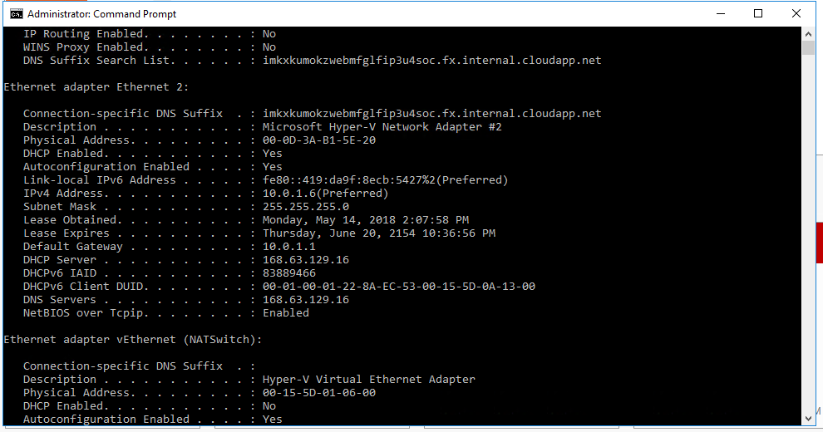
Wie lange ist die Lease time einer IP in Azure?
Sehr lange
1 Monat
24h
Notes:
ca. 136 Jahre...

Slide 48
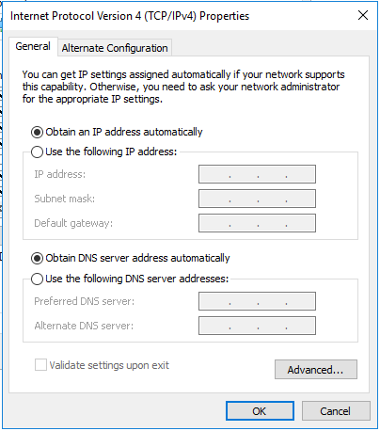
Wie könnten die IPv4 Einstellungen meiner Azure VM aussehen nach:…
New-AzureRmNetworkInterface -Name $NICName -ResourceGroupName $RG -Location $Location -SubnetId … -PublicIpAddressId … -PrivateIpAddress ‘10.0.1.4‘

Slide 49
IP Addresses in Virtual Network
Customer-managed private virtual networks within Microsoft Azure
“Bring your own IPv4 addresses”
Private IP address:
An internal IP assigned by Microsoft Azure DHCP to the VM
Associated automatically with the VM when created
It is released when VM is deleted or deallocated (default)
It is possible to configure and static IP address
You can have more than one Private IP per VM (Multi-NIC support)
Azure DHCP
You MUST not change the network configuration in OS’s NIC configuration.
Static IP address of a VM is configured on Azure DHCP so that the same IP address are allocated by Azure DHCP
You can’t run your own DHCP server in Virtual Network.
Notes:
VIP: The VIP is allocated at random from a pool of IP addresses managed by Microsoft. However, it is possible to reserve an IP address from the Microsoft pool and allocate that reserved IP address as a VIP. There is a limit of 5 reserved IPs for a subscription. Unless a reserved IP address is used, the VIP is given up and returned to the Microsoft pool once the last VM with that VIP is deallocated or deleted. Internet-bound traffic coming from the VM is SNATted to have the VIP be its source address.
DIP: This IP address is associated automatically with the VM when it is created and remains associated with it while it is deployed. The DIP survives system reboots as well as service healing migration of the VM. If the VM is deleted or changed into a stopped/deallocated state it loses its DIP, which may then be allocated to another VM. Alternatively, the DIP can be a static IP address allocated to the VM on creation. This address comes from the range configured for the subnet the VM is deployed into. It is a good practice to use a distinct subnet for statically-allocated DIPs to avoid the possibility of collision between a dynamically and statically allocated DIP.
PIP: A PIP is a public instance-level IP address associated with the VM in addition to the VIP. Traffic to the PIP goes directly to the VM and is not routed through the Azure Load Balancer. Internet-bound traffic from a VM with a configured PIP is also sent over the PIP rather than going through the VIP. The PIP must be appropriately firewalled to restrict traffic to only that desired. A PIP is useful for workloads such as passive FTP that require a large number of ports to be opened, which is impractical when using the VIP which supports only a limited number of endpoints.

Slide 50
Was muss ich tun damit sich beide VMs pingen können?
VM1 10.0.1.4
VM2 10.0.2.4
10.0.1.0/24
10.0.2.0/24
nichts!
10.0.0.0/16

Slide 51
und hier?
VM1 10.1.0.4
VM2 10.2.0.4
10.1.0.0/24
10.2.0.0/24

Slide 52
z.B. sowas:
VM1 10.1.0.4
VM2 10.2.0.4
10.1.0.0/24
10.2.0.0/24
Alternative: VNET Peering…

Slide 53
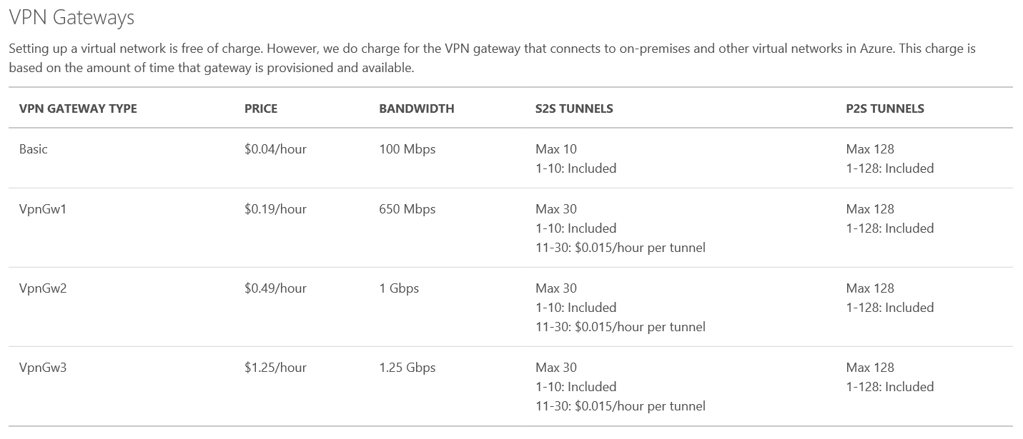
VPN Gateways…cost *)
Notes:
https://msdn.microsoft.com/en-us/library/azure/jj156075.aspx
Static and Dynamic routing gateways
When you create a site-to-site VPN, you’ll specify either a static, or dynamic gateway. Select the gateway type that is supported by your router and for the type of IPSec parameters and configuration that you require. The tables below show the supported configurations for both static and dynamic VPNs. If you plan to use a site-to-site configuration concurrently with a point-to-site configuration, you’ll need to configure a dynamic routing VPN gateway.
Static routing VPNs – Static routing VPNs are also referred to as policy-based VPNs. Policy-based VPNs encrypt and route packets through an interface based on a customer-defined policy. The policy is usually defined as an access list. Static routing VPNs require a static routing VPN gateway. Note - Multi-Site VPN, VNet to VNet, and Point-to-Site are not supported with static routing VPN gateways.
Dynamic routing VPNs – Dynamic routing VPNs are also referred to as route-based VPNs. Route-based VPNs depend on a tunnel interface specifically created for forwarding packets. Any packet arriving on the tunnel interface will be forwarded through the VPN connection. Dynamic routing VPNs require a dynamic routing VPN gateway. Note - A dynamic routing VPN gateway is required for Multi-Site VPN, VNet to VNet, and Point-to-Site.

Slide 54
Wie komme ich von zuhause auf meine VM?

Slide 55


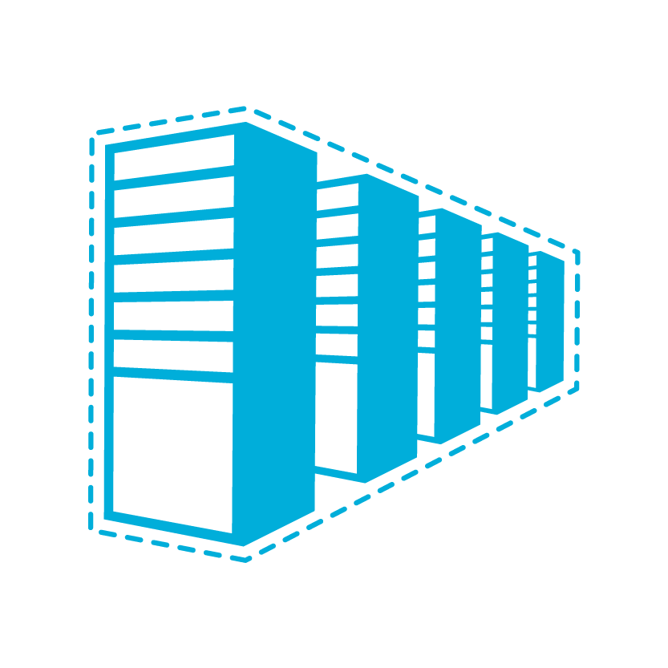

Microsoft Azure IaaS Connectivity Options
ENTERPRISE
CLOUD
Secure Machine-to-Machine Network Connectivity Point-to-Site
Secure Site-to-Site
Network Connectivity
Microsoft Azure Virtual Network
Secure Site-to-Site
Network Connectivity
Microsoft Azure Virtual Network
Private Site-to-Site Connectivity
Express Route
Notes:
Slide Objective
Microsoft stack to provide connectivity between on-premises and cloud.
Notes
Servicebus vs connect: Servicebus requires changes to application code; Connect/Virtual Networks do not require changes.
Virtual Networks are the net new here. They provide site-to-site connectivity where Connect provided server-to-server connectivity
Virtual Networks are the more flexible and powerful option
ExpressRoute picture depicts a partner supplied data connection with high-powered router going to Azure. Guaranteed bandwidth
[EDITOR] Zain Ahmed:
Thursday, October 03, 2013 Stack is a technical term but, in this context, seems to refer to a layered collection of services and/or features (based on the image on the slide). Is the word “stack” still applicable here, based on more than just the appearance of the image? If not, kindly replace with a more appropriate word.
[EDITOR] TWB_Trevor:
08 October 2013 Does Servicebus here refer to Microsoft Azure Service Bus? If so, it should be two words, and used as “Microsoft Azure Service Bus” since this is the first occurrence of the word.
Also, what does “connect” refer to here? The context of the word is not clear. It is a reference to “Microsoft Azure Connect”? If so, kindly note that the feature was deprecated on 7/3/2013 and may not be acceptable to reference in content.
Finally, are “Microsoft Azure Connect” and “Microsoft Azure Virtual Network” interchangeable? They have been separated by a slash, here, which implies “or”. If the message should be “and”, the actual word should be used instead of the slash.

Slide 56

Point-to-Site *)
The Corp. HQ
Virtual Network
SQL Server
WA Web Role
VPN Tunnel
Client 1
Certificate
VPN Client Package
Notes:
Slide Objective
Enable customers to extend individual existing machines in their Enterprise Networks into Microsoft Azure:
Replacement for Microsoft Azure Connect
Support for “hybrid” apps that span the cloud and on-premises
Notes
You will create a virtual network in Azure
This virtual network is identical to virtual networks you have been building in the past, except that you will select Point-To-Site in the Wizard
You still need a VPN gateway device or Windows Server 2012 with Routing and Remote Access Service (RRAS) setup
Install a certificate on both sides
Install the VPM client package
[EDITOR] TWB_Trevor:
09 October 2013 Kindly provide some context to “sides” here.

Slide 57


Site-to-Site Connectivity
Windows Azure
Extend your on-premises to the cloud securely
On-ramp for migrating services to the cloud
Use your on-premises resources in Azure (monitoring, AD, …)
<subnet 1>
<subnet 2>
<subnet 3>
Virtual Network
DNS Server
Site-to-Site VPN
On-premises
VPN Gateway
VPN Gateway
Hardware VPN or Windows RRAS
Your datacenter

Slide 58
Internet based connection
Customer site 2
Azure
Private Network
Customer site 1
Public internet
Customer DC

Slide 59
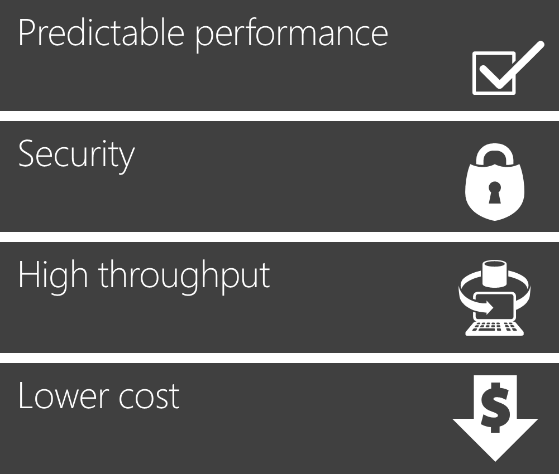
Private connection with ExpressRoute
ExpressRoute provides organizations a private, dedicated, high-throughput network connection between Windows Azure datacenters and their on-premises IT environment.
Customer site 2
Azure
Private Network
Customer site 1
Public internet
Customer DC

Slide 60





ExpressRoute connectivity models
Cloud exchange co-location
Point-to-point Ethernet connection
Any-to-any (IP VPN) connection
ExpressRoute
ExpressRoute
ExpressRoute
Exchange
WAN

Slide 61

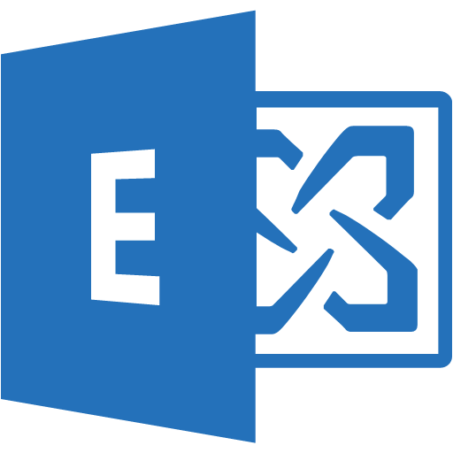
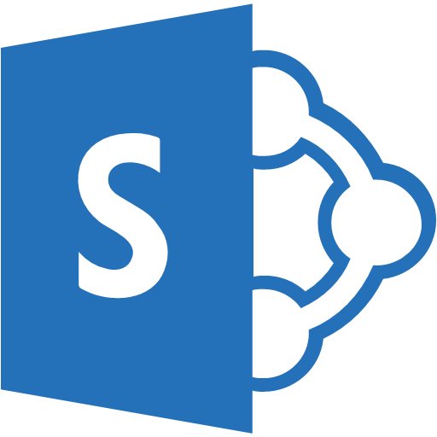












ExpressRoute Peerings and Microsoft Cloud Services
ER uses different BGP sessions for different cloud services
Partner Edge
Microsoft Edge
Customer’s network
ExpressRoute
“Microsoft Peering” - BGP Session: Traffic to Office 365 Services
“Azure Public Peering” - BGP Session: Traffic to public IP addresses in Azure (Azure Storage, SQL DB, PaaS)
“Azure Private Peering” - BGP Session”: Traffic to Virtual Networks

Slide 62

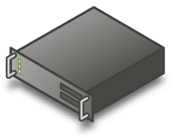
OnPrem <-----> Azure Demo Config
Router
ExpressRoute
AzureVM
OnPremiseServer
10.1.0.4
192.168.205.2
Notes:
172.16.22.1 -LocalASN 65120
10.1.0.0/24

Slide 63




OnPrem <-----> Azure Demo Config with Private Peering
BGPRouter
172.16.22.2/30
192.168.205.1
VLANID:101
VLANID:101
ASN: 12076
(official Azure ASN number)
ExpressRoute
172.16.22.1/30
VLANID:123
ASN: 65121
VPN Gateway
CloudVM
192.168.205.2
OnPremiseVM
10.1.0.4
GatewaySubnet 10.1.1.0/28
VMSubnet1 10.1.0.0/24
Link zu Full-Video
VNET 10.1.0.0/16
Notes:
172.16.22.1 -LocalASN 65120
10.1.0.0/24

Slide 64

Public IP addresses
Public IP Addresses in Azure
Can be used for instance (VM) level access or load balancing
Instance-level IP (ILPIP)
Internet IP assigned exclusively to single VM Entire port range accessible by default
Primarily for targeting a specific VM
Load balanced IP (VIP)
Internet IP load balanced among one or more VM instances
Allows port redirection
Primarily for load balanced, highly available, or auto-scale scenarios
Internet
151.2.3.4 (VIP)
LB
131.3.3.3
(Instance-level IP)
131.3.4.4
(Instance-level IP)
VM1
VM2
IP1
IP2
Microsoft Azure
Notes:
This slide is used to discuss the combination of both the public IP addresses that Azure can provide to individual VMs + load balancing between them.
http://azure.microsoft.com/blog/2014/10/22/instance-level-public-ip-address/
You can now have Azure provide public IP addresses to individual VMs, maybe so you can use the machine as an FTP server
An instance level public IP is not load balanced
The entire port range is accessible by default. Typically, to be able to send traffic to an Azure VM from an external source, the destination port must be declared as an Endpoint in the VM, but with Instance-Level Public IPs this restriction is removed. An external source can send traffic to any port on the Instance-Level Public IP Address as long the firewall in the VM allows it. This is particularly useful when the VM needs to receive traffic on dynamic ports, a good use case being FTP servers implementing passive mode

Slide 65
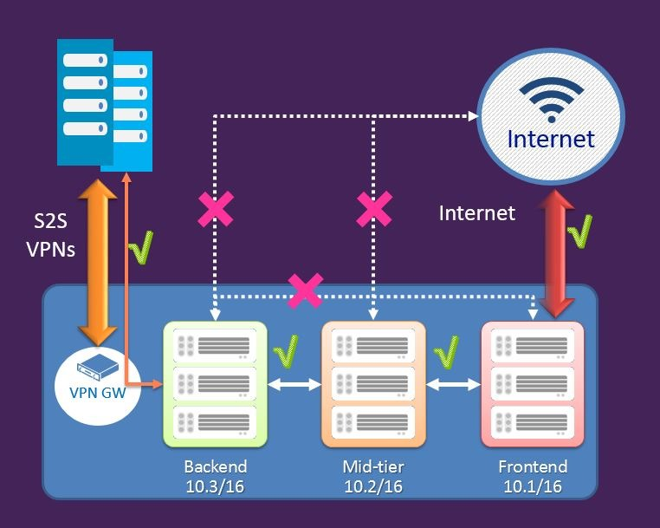
Network Security Groups (NSG)
Define access control rules for inbound/outbound traffic to a VM or group of VMs in a subnet
NSG rules can be changed at any time and apply to all instances
NSG can be associated with:
A single VM in a VNet
A subnet in a VNet
A VM and a Subnet together for added security
Rules are processed in order of priority
Rules are based on 5-tuple (source/dest IP/port, protocol)
Notes:
You can now create Network Security groups to define access control rules for inbound and outbound traffic to a Virtual machine or a group of virtual machines in a subnet. The security groups and the rules can be managed and updated independent of the life cycle of the VM.
http://azure.microsoft.com/blog/2014/10/29/networking-enterprise/
https://anderseideblog.wordpress.com/2014/10/30/network-security-groups-in-azure/
http://msdn.microsoft.com/en-us/library/azure/dn848316.aspx
added note that rules are based on the 5-tuple (source/dest IP/port, protocol)

Slide 66
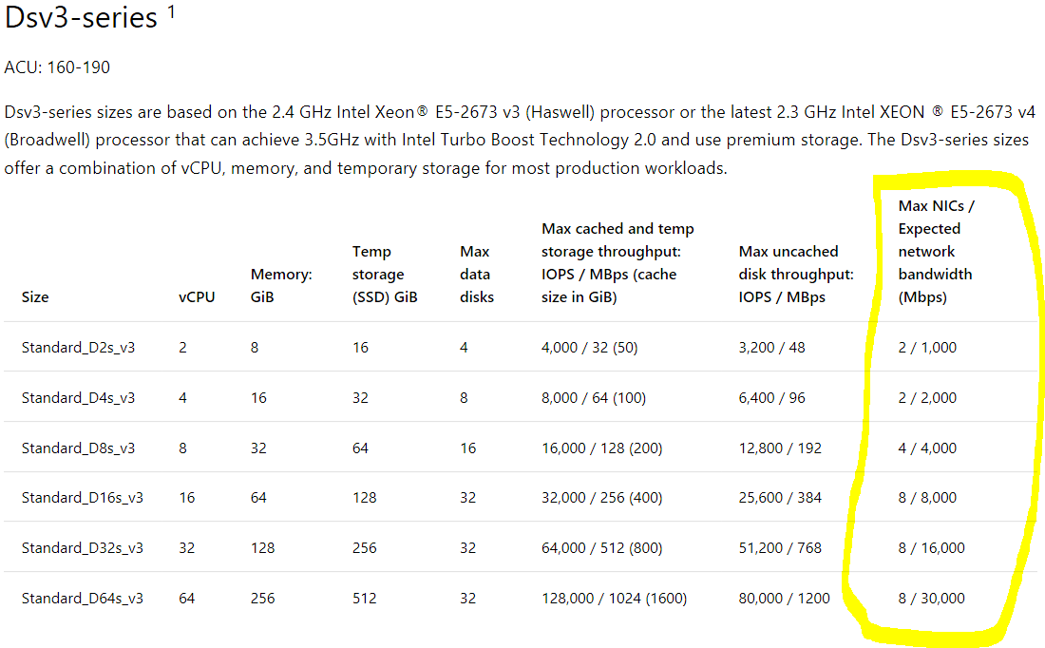
Was kann ich tun um mehr Netzwerkperformance für meine Azure VM zu kriegen*)
Receive Side Scaling (RSS) aktivieren
Accelerated Networking nutzen
Mehr vNICs ‚einbauen‘
zu einer größeren VM wechseln
BTW: outbound (VM) – d.h. egress
Optimize network throughput for Azure virtual machines
Create a Windows virtual machine with Accelerated Networking
Notes:
Accelerated networking enables single root I/O virtualization (SR-IOV) to a VM, greatly improving its networking performance. This high-performance path bypasses the host from the datapath, reducing latency, jitter, and CPU utilization, for use with the most demanding network workloads on supported VM types.
Bandwidth testing….
https://docs.microsoft.com/en-us/azure/virtual-network/virtual-network-bandwidth-testing

Slide 67
Wer oder was macht in Azure eigentlich das Ressourcen Management?

Slide 68
Managing Azure Deployments
Azure Service Manager (ASM)
Traditional way to deploy and manage applications hosted in Azure
Azure Portal https://manage.windowsazure.com
PowerShell / CLI (default mode)
REST API
Azure Resource Manager (ARM)
Modern way to deploy and manage applications hosted in Azure
Azure Portal https://portal.azure.com
PowerShell / CLI (ARM mode)
REST API
Azure Resource Management Library for .NET
Notes:
Introduce the two ways to manage Azure services.
ASM has been around since 2009 and is getting long in the tooth.
ARM supports modern deployment practices. It is designed to be extensible to all current and future services.
Since we currently have two different APIs in use in Azure, we want to explain, although not very deeply, that in the CURRENT portal and V1/Classic, the resources are categorized and accessed via a REST API named ‘Service Management API’. Primarily, access to this portal and items in Azure through this API has been through the use of certificates and then later Microsoft has started adding the capability of using Azure AD through the use of Add-AzureAccount.
An IT Pro rarely, if ever, will use the API directly, although all other Azure tools do use the API. So, the programmatic aspect of this is not really relevant, but as of the ARM API, how the VMs are accessed has completely changed because of the different API.
NOTES
For now it’s not possible to upload a management certificate with the SMAPI (which makes sense as accessing the SMAPI requires a management certificate…). You instead have to upload it via the portal
The subscription ID forms part of the URI, which is in line with the fact that the Subscription in the security boundary for the administration of the resources.

Slide 69
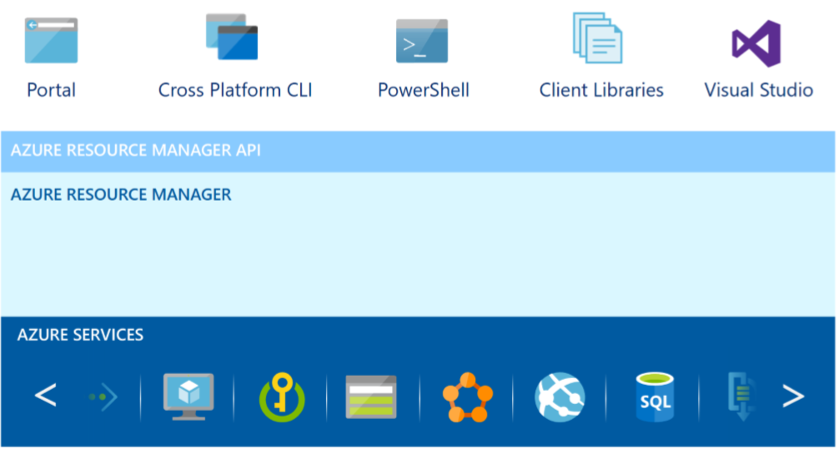
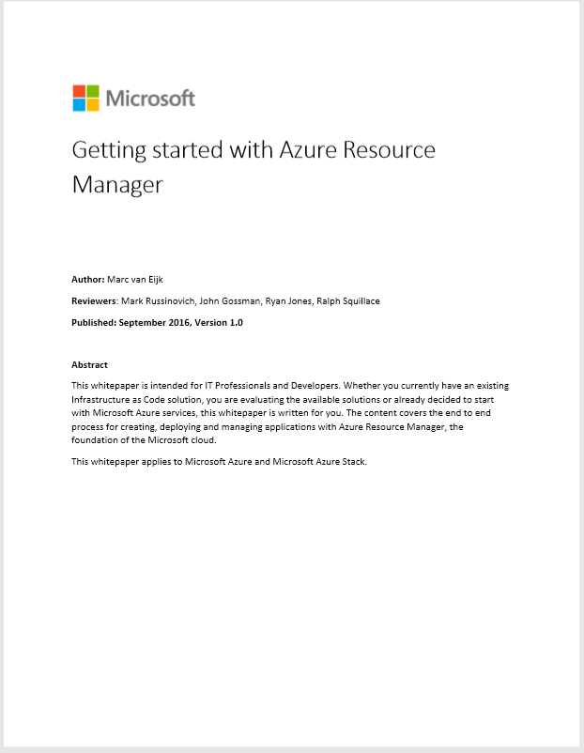
Azure Resource Manager (ARM)
Provides a management layer to create and operate your Azure resources
Azure cloud platform provided can be divided into 4 layers:
End-user experience
Unified Application model
Services
Cloud infrastructure
*) Getting started with Azure Resource Manager
*)
Notes:
https://docs.microsoft.com/en-us/azure/azure-resource-man
resource - A manageable item that is available through Azure. Some common resources are a virtual machine, storage account, web app, database, and virtual network, but there are many more.
resource group - A container that holds related resources for an Azure solution. The resource group can include all the resources for the solution, or only those resources that you want to manage as a group. You decide how you want to allocate resources to resource groups based on what makes the most sense for your organization. See Resource groups.
resource provider - A service that supplies the resources you can deploy and manage through Resource Manager. Each resource provider offers operations for working with the resources that are deployed. Some common resource providers are Microsoft.Compute, which supplies the virtual machine resource, Microsoft.Storage, which supplies the storage account resource, and Microsoft.Web, which supplies resources related to web apps. See Resource providers.
Resource Manager template - A JavaScript Object Notation (JSON) file that defines one or more resources to deploy to a resource group. It also defines the dependencies between the deployed resources. The template can be used to deploy the resources consistently and repeatedly. See Template deployment.
declarative syntax - Syntax that lets you state "Here is what I intend to create" without having to write the sequence of programming commands to create it. The Resource Manager template is an example of declarative syntax. In the file, you define the properties for the infrastructure to deploy to Azure.
ager/resource-group-overview

Slide 70
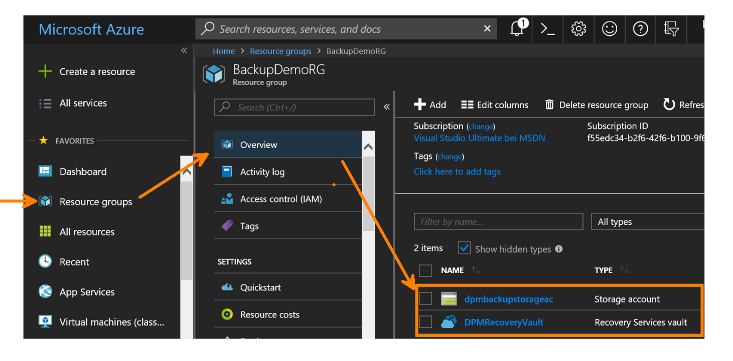
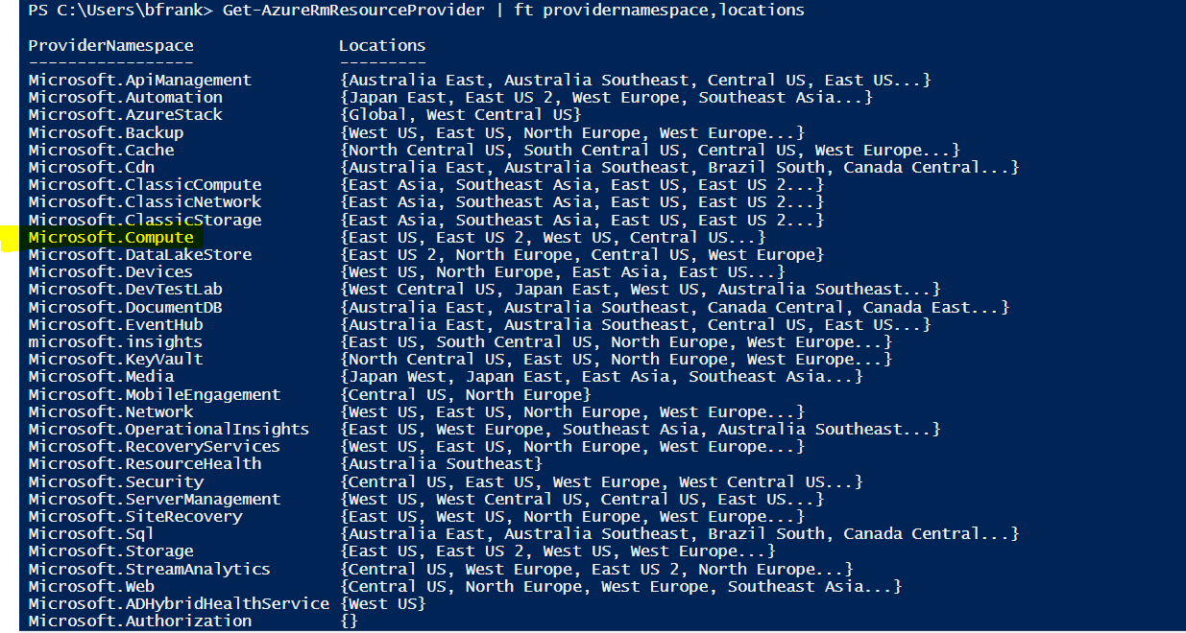
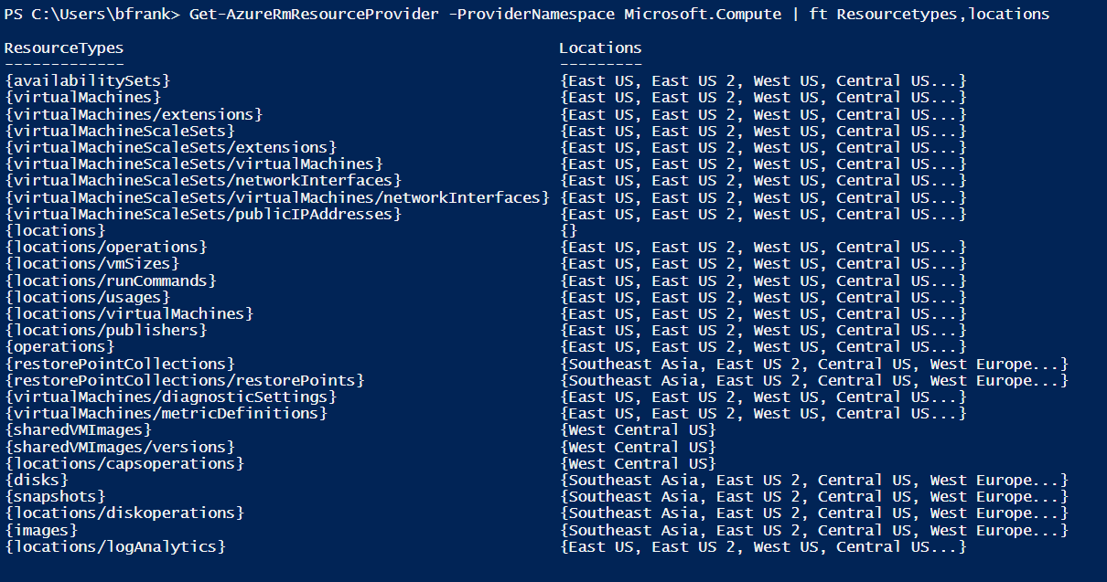
Azure Resource Manager (ARM)
[Terminology]
Resource (virtualNetworks, publicIPAddresses, networkInterfaces, disks, ... )
Resource Group
Resource Provider
Notes:
https://docs.microsoft.com/en-us/azure/azure-resource-man
resource - A manageable item that is available through Azure. Some common resources are a virtual machine, storage account, web app, database, and virtual network, but there are many more.
resource group - A container that holds related resources for an Azure solution. The resource group can include all the resources for the solution, or only those resources that you want to manage as a group. You decide how you want to allocate resources to resource groups based on what makes the most sense for your organization. See Resource groups.
resource provider - A service that supplies the resources you can deploy and manage through Resource Manager. Each resource provider offers operations for working with the resources that are deployed. Some common resource providers are Microsoft.Compute, which supplies the virtual machine resource, Microsoft.Storage, which supplies the storage account resource, and Microsoft.Web, which supplies resources related to web apps. See Resource providers.
Resource Manager template - A JavaScript Object Notation (JSON) file that defines one or more resources to deploy to a resource group. It also defines the dependencies between the deployed resources. The template can be used to deploy the resources consistently and repeatedly. See Template deployment.
declarative syntax - Syntax that lets you state "Here is what I intend to create" without having to write the sequence of programming commands to create it. The Resource Manager template is an example of declarative syntax. In the file, you define the properties for the infrastructure to deploy to Azure.
ager/resource-group-overview

Slide 71
…und wie lege ich diese vielen Ressourcen jetzt (in der richtigen Reihenfolge) an?
von Hand im Portal
via PowerShell
mittels Azure Resource Manager Templates

Slide 72
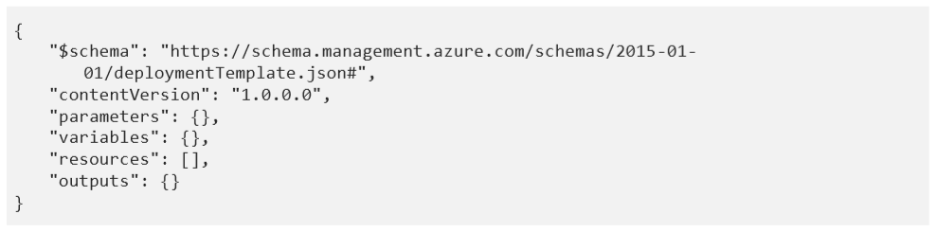
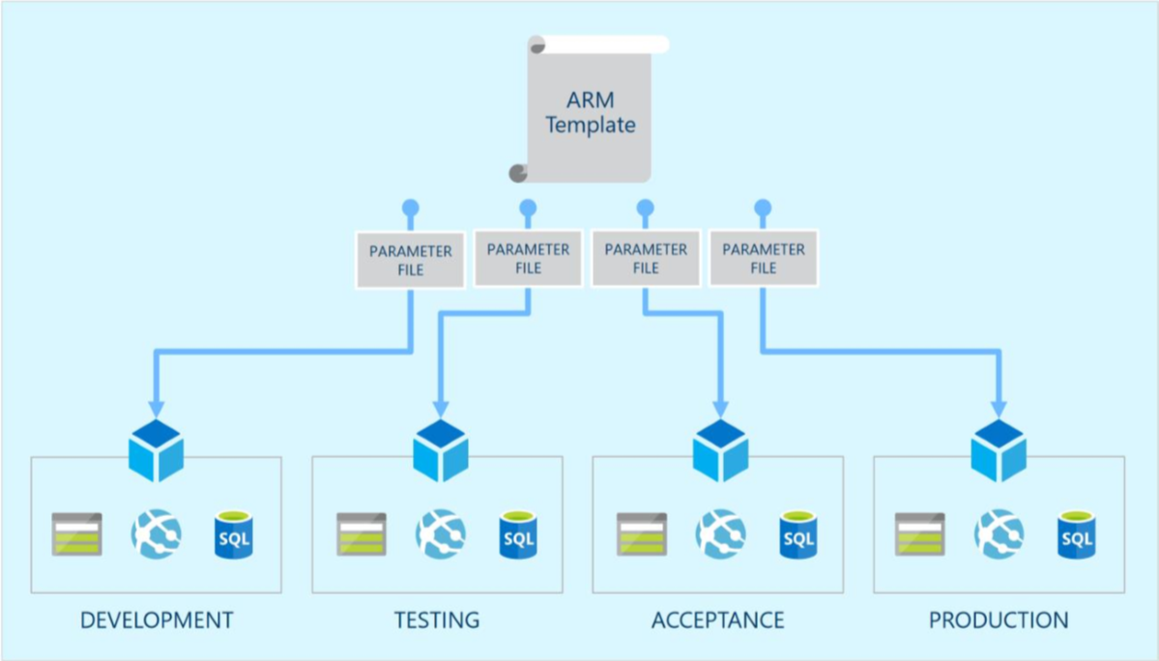
Azure Resource Manager (ARM)^{*)}
Infrastructure as Code with Resource Manager Templates
Describes resources and dependencies
Are idempotent
Simplify redeployment, orchestration & rollback
Is deployment IP: Treat as source code
Azure Quickstart Templates
Notes:
Azure Templates can:
Ensure Idempotency
Simplify Orchestration
Simplify Roll-back
Provide Cross-Resource Configuration and Update Support
Azure Templates are:
Source file, checked-in
Specifies resources and dependencies (VMs, WebSites, DBs) and connections (config, LB sets)
Parametized input/output

Slide 73
Wem das zu abgefahren ist PowerShell geht auch...;-)

Slide 74
Demo>
_
Deploy VM using PowerShell – e.g. SingleVM
Deploy using Azure Quickstart Templates

Slide 75
Gibt es ein Auftragsdatenverarbeitungs-Dokument für Azure?

Slide 76
„Auftragsdatenverarbeitung“ -> siehe Online Service Terms…
http://www.microsoftvolumelicensing.com/DocumentSearch.aspx?Mode=3&DocumentTypeId=46 und im Trust Center https://www.microsoft.com/de-de/trustcenter/
Anmerkung: Bei CSP ist der Nutzer unser Services der Endkunde (nicht der Partner!). Das wird leider immer von unseren Partner verwechselt. Zwischen dem Kunden als den Nutzer der Azure Services und Microsoft als der Lizenzgeber gelten damit die OST Terms, die Bestandteil des MCAs sind, den der Endkunde akzeptiert.
Siehe OST u.a.:
Datenschutzbestimmungen
Anhang 3 – Die Standardvertragsklauseln (Prozessoren)
Anlage 4 – Bestimmungen der Datenschutz-Grundverordnung der Europäischen Union

Slide 77
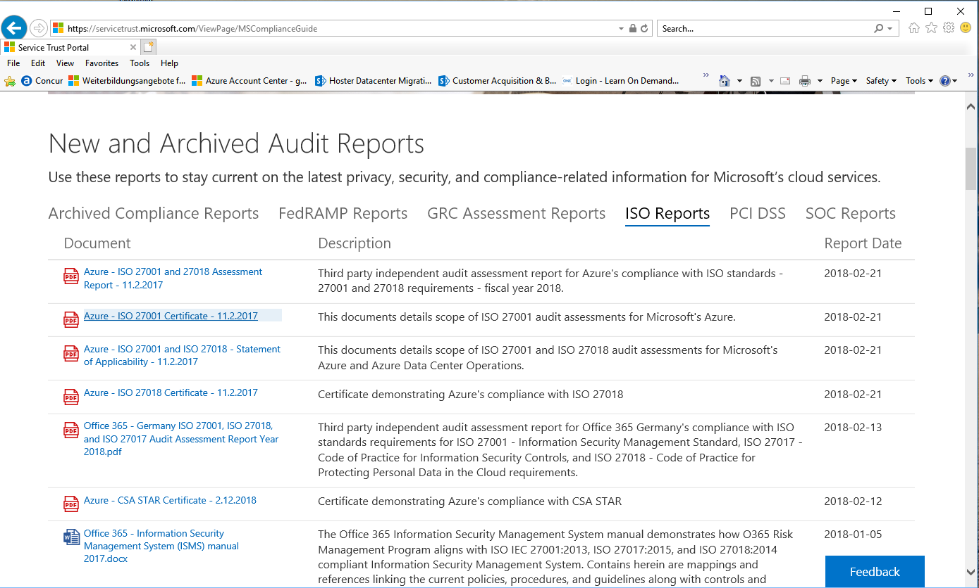
Was mache ich unter welcher URL?
Internationales Azure Portal
(ARM) portal.azure.com
Subscriptions Verwalten: z.B.
Rechnung (.pdf)
Usage (.csv) runterladen
Spending Limit aufheben
https://account.windowsazure.com/Subscriptions
Microsoft Cloud Deutschland
(ARM) portal.microsoftazure.de
Cloud Solution Provider Portal:
z.B. Neue Kunden anlegen, MS Cloud Services (O365, Azure) zuweisen,…
http://partnercenter.microsoft.com/
Azure Preiskalkulator*)
Trustcenter*)
Security, Privacy, Compliance
Service Trust Audit Reports herunterladen *)

Slide 78
Ready for the cloud?
onprem -> what can / should be moved to azure
Microsoft Azure Virtual Machine Optimization Assessment
Azure Migrate
when in Azure - optimize:
Azure Virtual Machine Readiness Assessment
Azure Advisor

Slide 79
Eine VM gleichen Typs ist in Westeuropa … als in Nordeuropa.
gleich teuer
teuerer
günstiger
Azure Preisrechner

Slide 80
Was kann ich tun um Kosten zu sparen? Ich,…
fahre das OS runter
stoppe die VM im Portal
nutze das Auto Shutdown feature
resize die VM
Cost Optimization in Azure

Slide 81
Azure Limits *)
Wie viele statische öffentliche IP Adressen kann ich in Azure nutzen?
a) 5
b) 1
c) Es gibt kein Limit.
d) 20
Notes:
https://docs.microsoft.com/en-us/azure/azure-subscription-service-limits

Slide 82
Welche Windows Server Roles/Features sind in Azure supported?,…
Network Load Balancing
RRAS
Hyper-V
https://support.microsoft.com/en-us/help/2721672/microsoft-server-software-support-for-microsoft-azure-virtual-machines

Slide 83
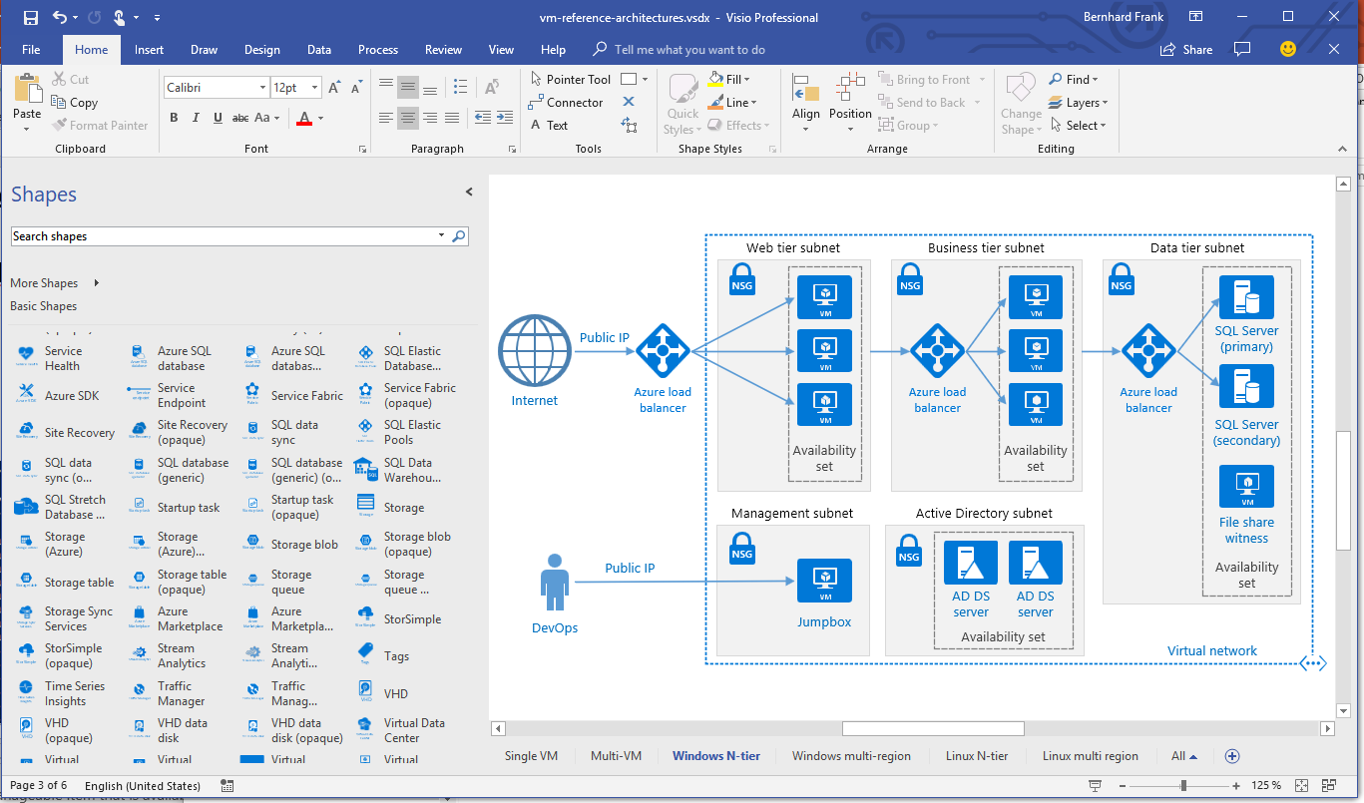
Wenn man Architekturen “malen” muss,…
Beispiel Architekturen *)
Beispiel Visio bei Azure Reference Architectures *)
Microsoft_CloudnEnterprise_Symbols_v2.7

Slide 84
Habe ich etwas vergessen?
Bestimmt!

Slide 85
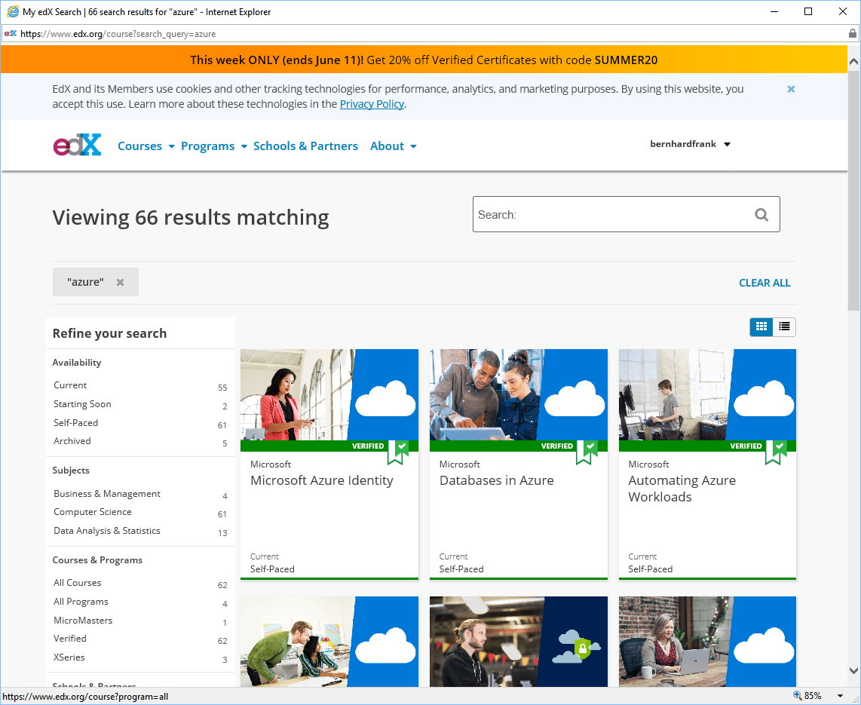
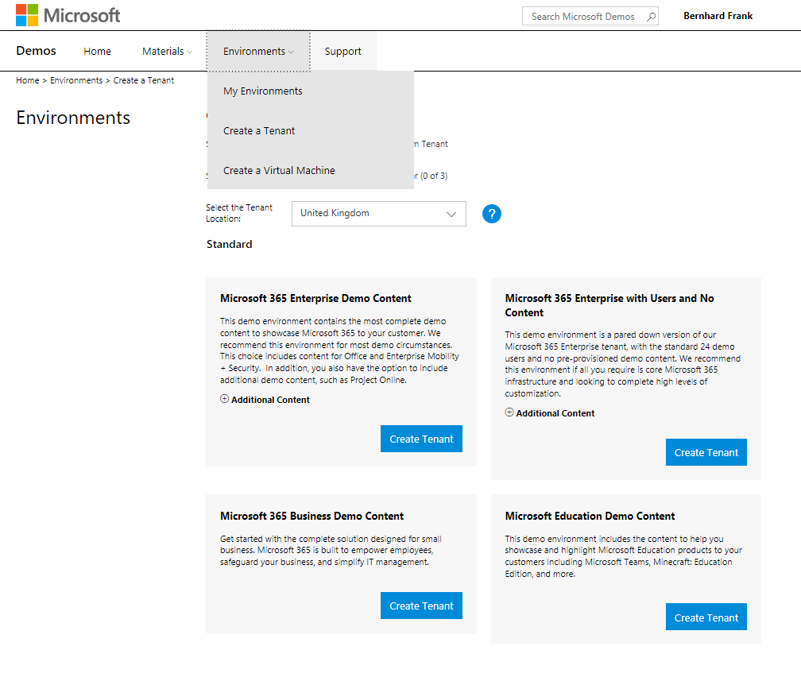
2 Wichtige Links…
Demo Account / Trials / Subscriptions
https://demos.microsoft.com/
Learning (Kostenlos):
https://www.edx.org/course?search_query=azure

Slide 86
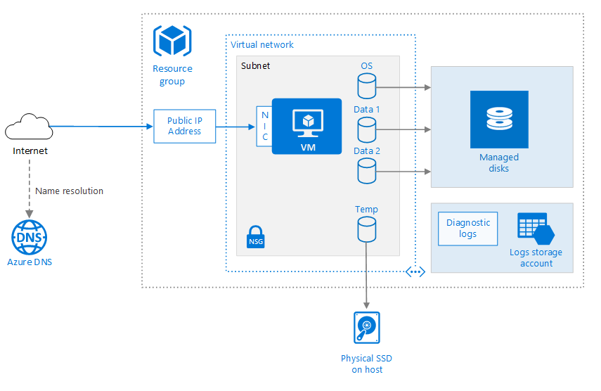
Hausaufgabe ;-)
Single VM *)
mein PowerShell Skript

Slide 87
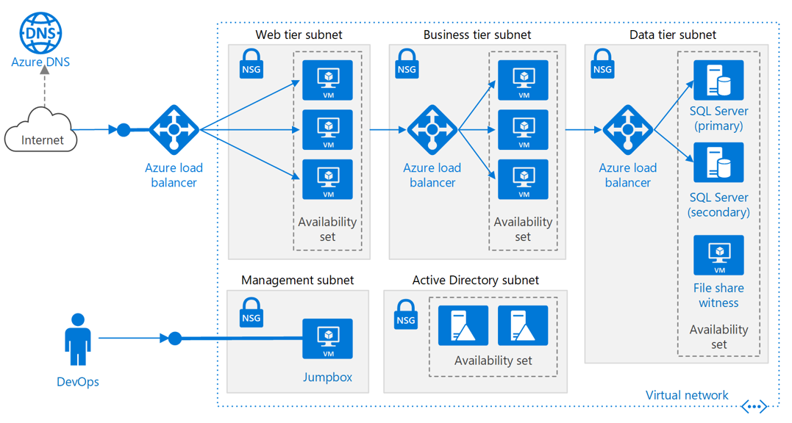
Fleißaufgabe…
N-Tier App *)

Slide 88

Fragen ?

